Slide 1
React JS Tutorial
By
Karthick Kumar

Slide 2
What is React.js?
Developed by Facebook
React is a view layer library, not a framework like Backbone, Angular etc.
You can't use React to build a fully-functional web app

Slide 3
Why was React developed?
Complexity of two-way data binding
Bad UX from using "cascading updates" of DOM tree
A lot of data on a page changing over time
Complexity of Facebook's UI architecture
Shift from MVC mentality

Slide 4

Who uses React?

Slide 5
React - The good
Easy to understand what a component will render
Declarative code → predictable code
You don't really need to study JS in the view file in order to understand what the file does
Easy to mix HTML and JS
You do it already with template libraries
No complex two-way data flow
Uses simple one-way reactive data flow
Easier to understand than two-way binding
React is fast!
Real DOM is slow

Slide 6
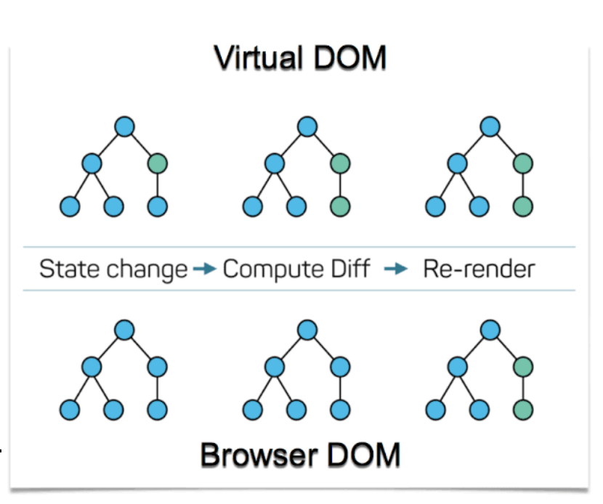
Virtual DOM
The VDOM is a high level lightweight in-memory tree representation of actual DOM.
Create a VDOM with a new state
Compare it with older VDOM using diffing.
Update only differ nodes in real DOM.
Assign new VDOM as older VDOM.

Slide 7
React - The bad
React is nothing but the view
No events
No XHR
No data / models
No promises / deferreds
No idea how to add all of the above
Very little info in the docs
Building JSX requires some extra work
No support for older browsers

Slide 8
Why should I use React?
Easy to read and understand views
Concept of components is the future of web development
Understanding how it works will take time and will slow you down at first (but once you and your team get it, things will start happening much faster)
If your page uses a lot of fast updating data or real time data - React is the way to go
Once you and your team is over the React's learning curve, developing your app will become a lot faster

Slide 9
How React Works?

Slide 10
Code-Splitting
Bundling is the process of following imported files and merging them into a single file called Bundle
This bundle can then be included on a webpage to load an entire app at once
Bundling is great, but as your app grows, your bundle will grow too. Especially if you are including large third-party libraries.
Code-Splitting is a feature supported by bundlers like Webpack, Rollup and Browserify

Slide 11
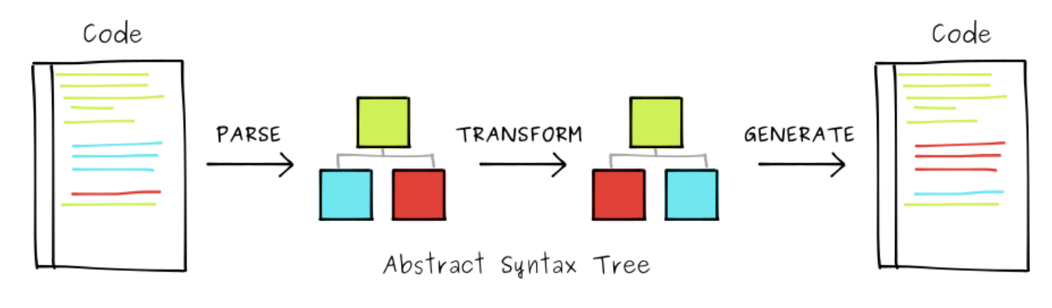
What is Babel?
Babel is a JavaScript transpiler that converts edge JavaScript into plain old ES5 JavaScript that can run in any browser
It makes available all the syntactic sugar that was added to JavaScript with the new ES6 specification, including classes, fat arrows and multiline strings.

Slide 12
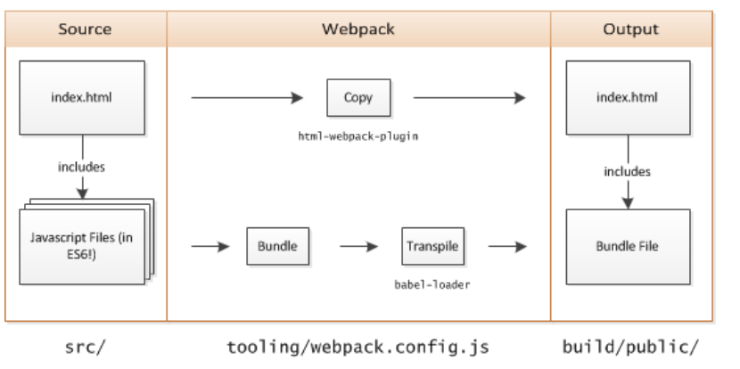
What is Webpack?
Webpack is a popular module bundling, it can handle combination and minification of JavaScript and CSS files
When you bundle a project using webpack, it traverses the imports, constructing a dependency graph of the project and then generates output based on the configuration.

Slide 13
React Installation

Slide 14
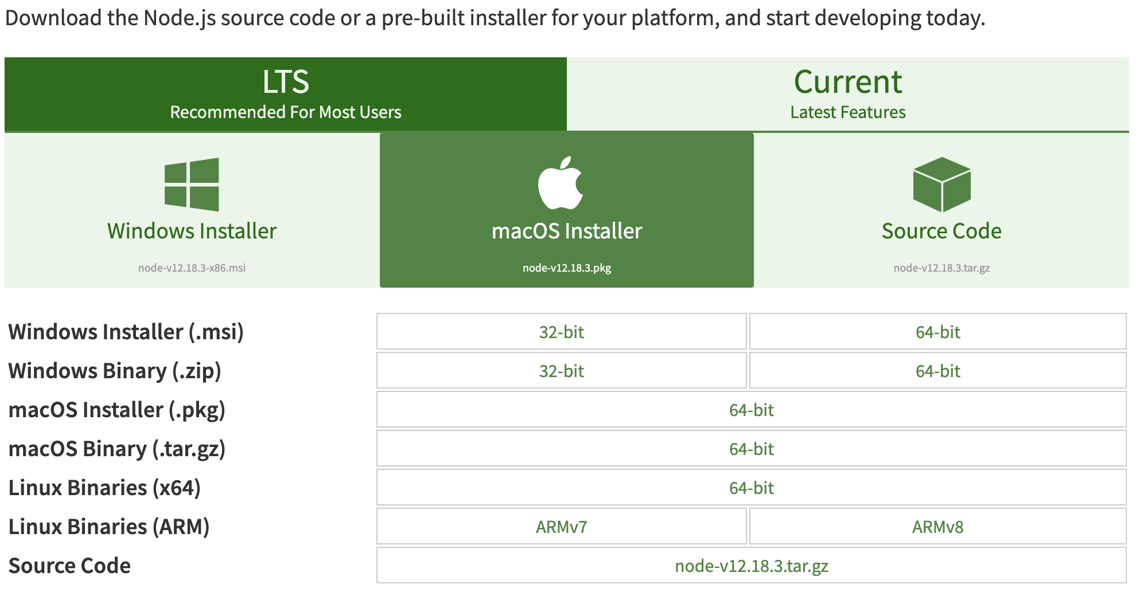
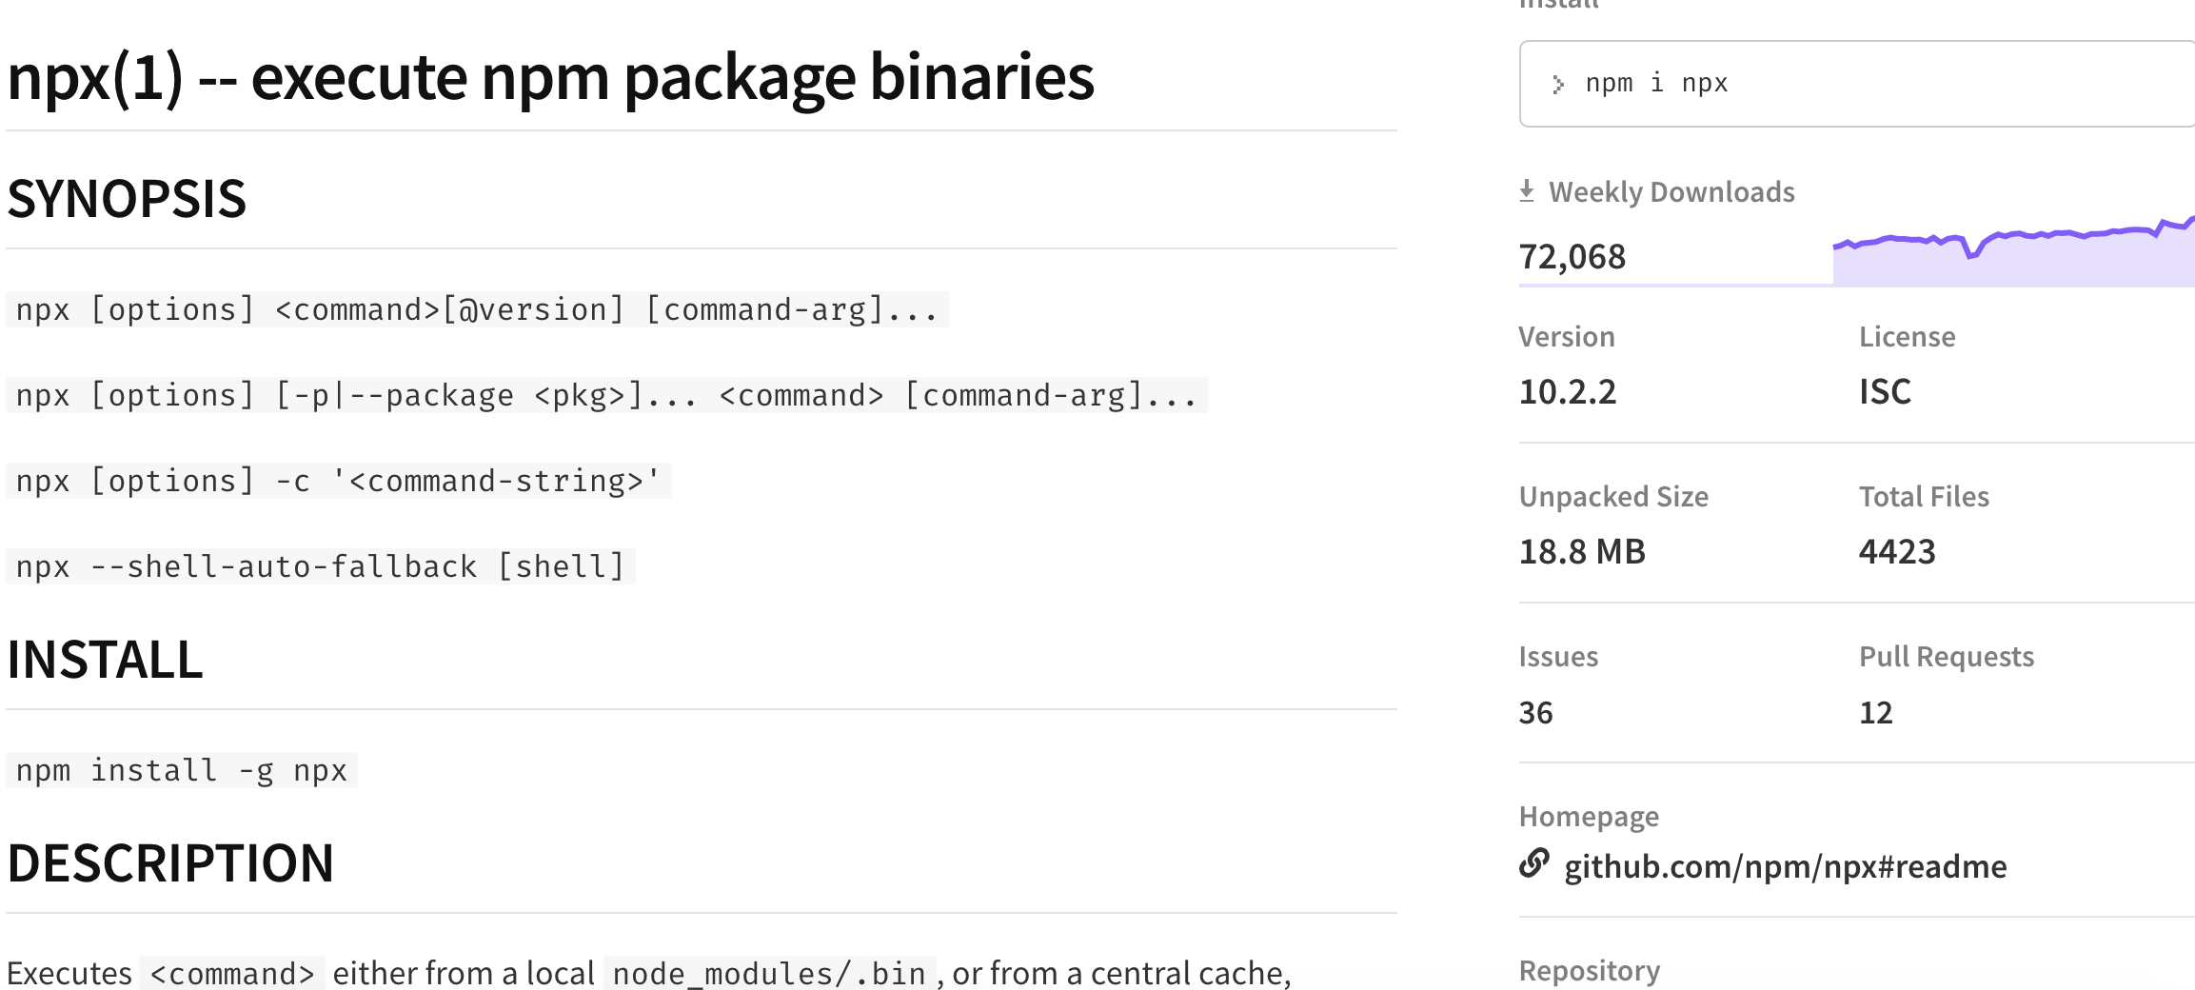
Required Software
Node js - https://nodejs.org/en/download/
Execute NPM package Binaries - https://www.npmjs.com/package/npx

Slide 15
React Project Creation

Slide 16
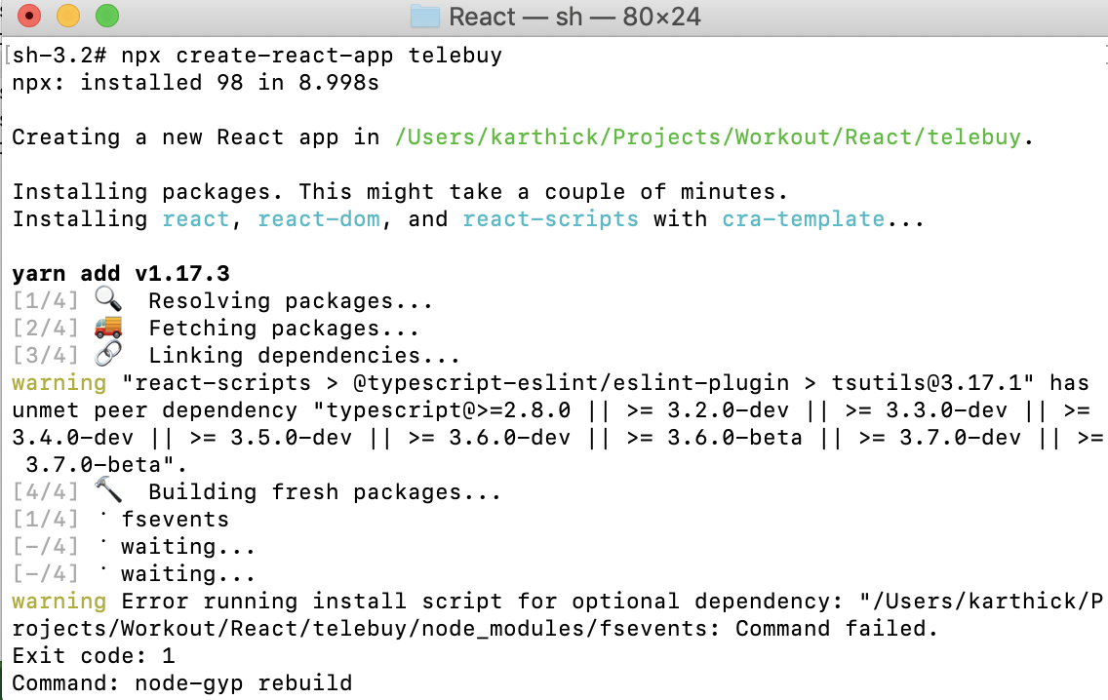
To create new React App

Slide 17
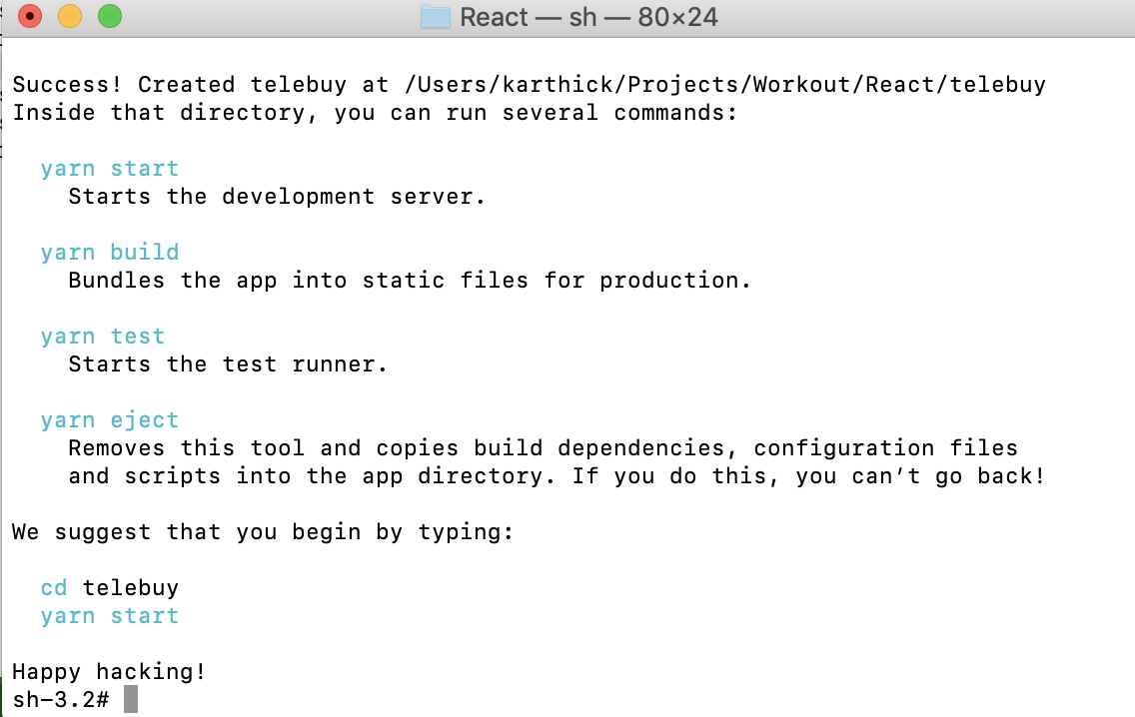

Slide 18
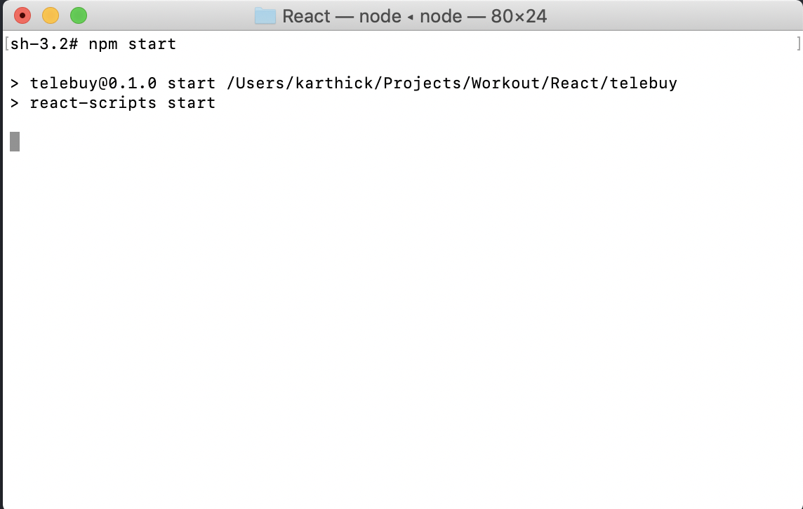
Navigate to Project folder and Run the command React App

Slide 19
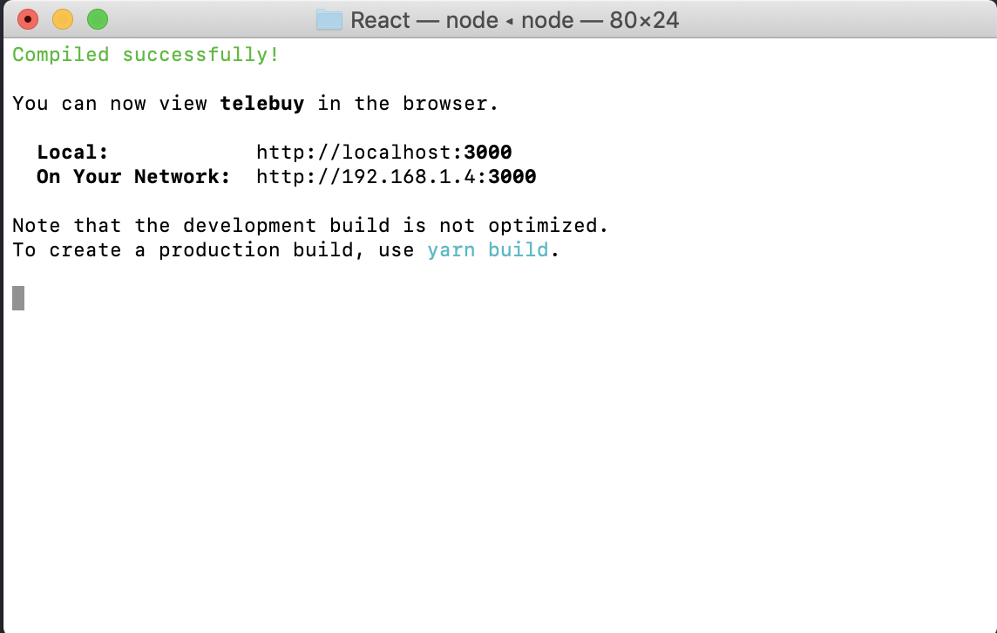

Slide 20
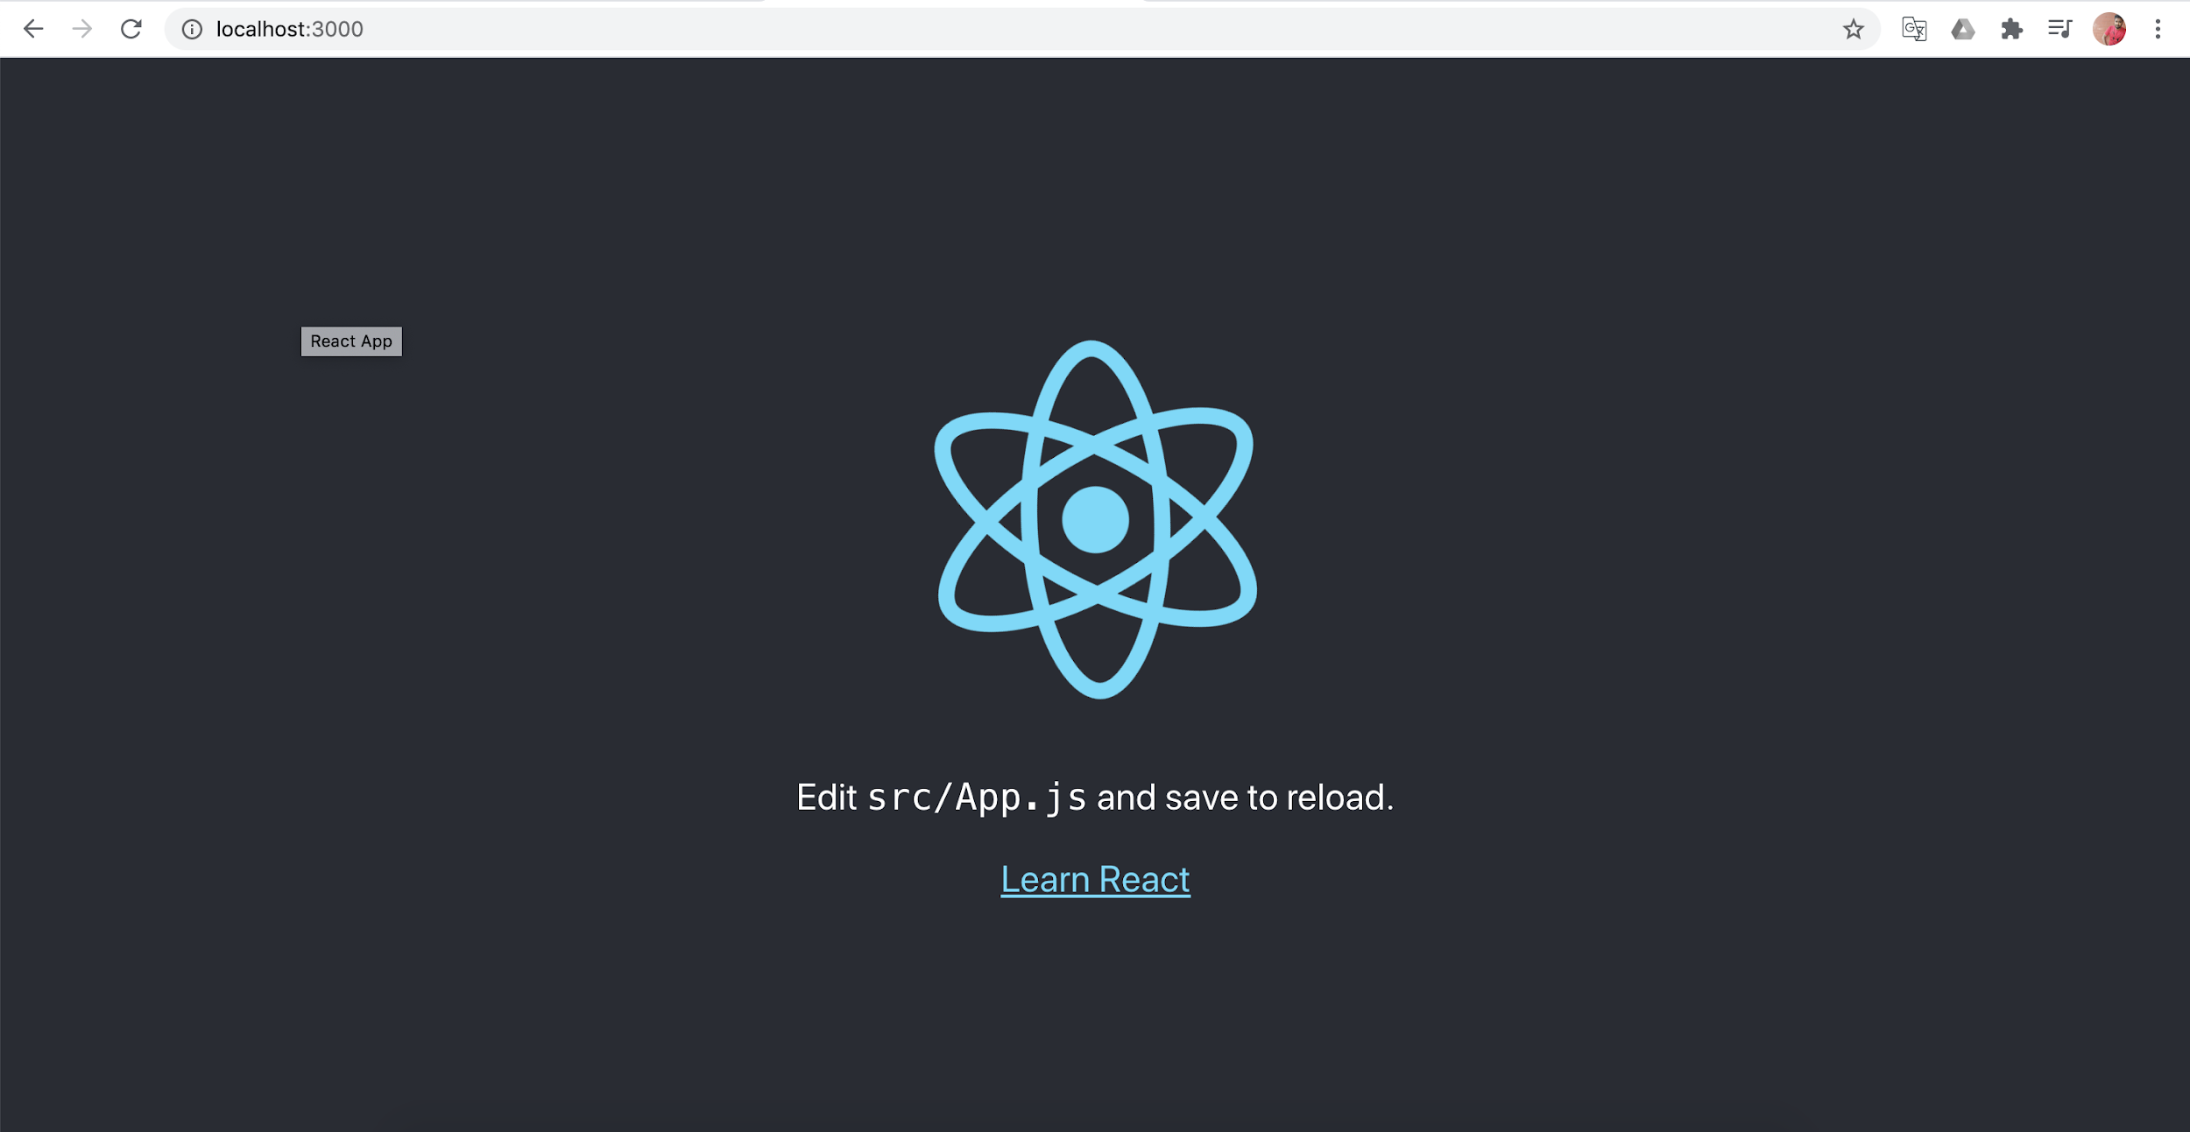

Slide 21
Folder Structure

Slide 22
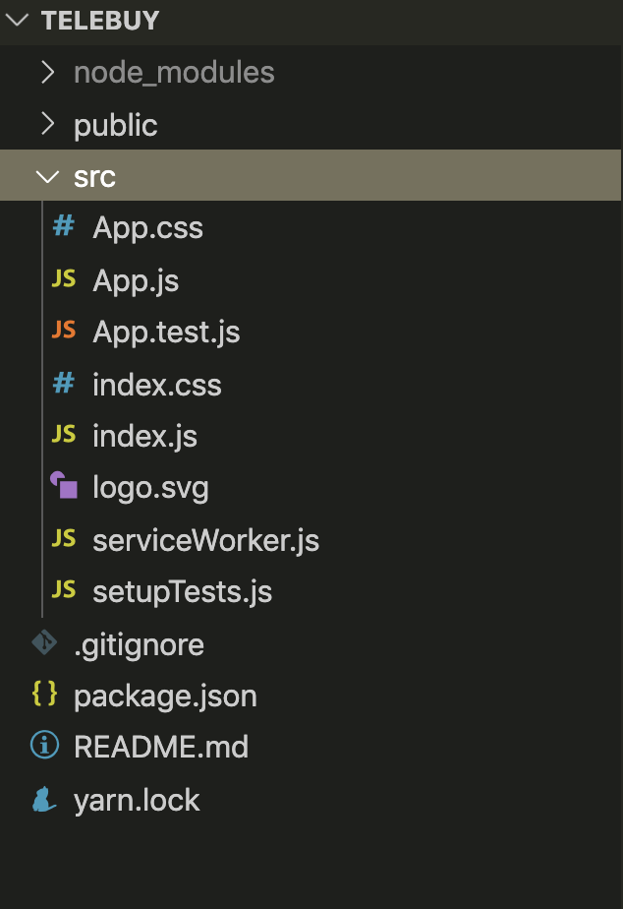
Main JS file

Slide 23
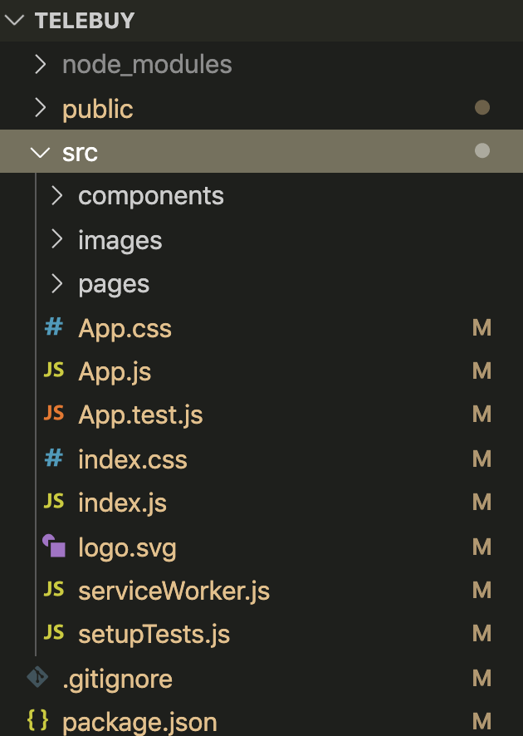
Create New Folders

Slide 24
Components

Slide 25
What is Components?
Components are independent and reusable bits of code. They serve the same purpose as JavaScript functions, but work in isolation and returns HTML via a render function.
They are like functions that return HTML elements.
Components come in two types, Class components and Function components, in this tutorial we will concentrate on Class components.
There are mainly two components in React:
Functional Components also known as (Stateless Component)
Class Component also known as (Stateful Component)

Slide 26
Functional Component (Stateless)
It is simple javascript functions that simply returns html UI
It is also called “stateless” components because they simply accept data and display them in some form that is they are mainly responsible for rendering UI.
It accept properties(props) in function and return html(JSX)
It gives solution without using state
There is no render method used in functional components.
These can be typically defined using arrow functions but can also be created with the regular function keyword.

Slide 27
Handling Events

Slide 28
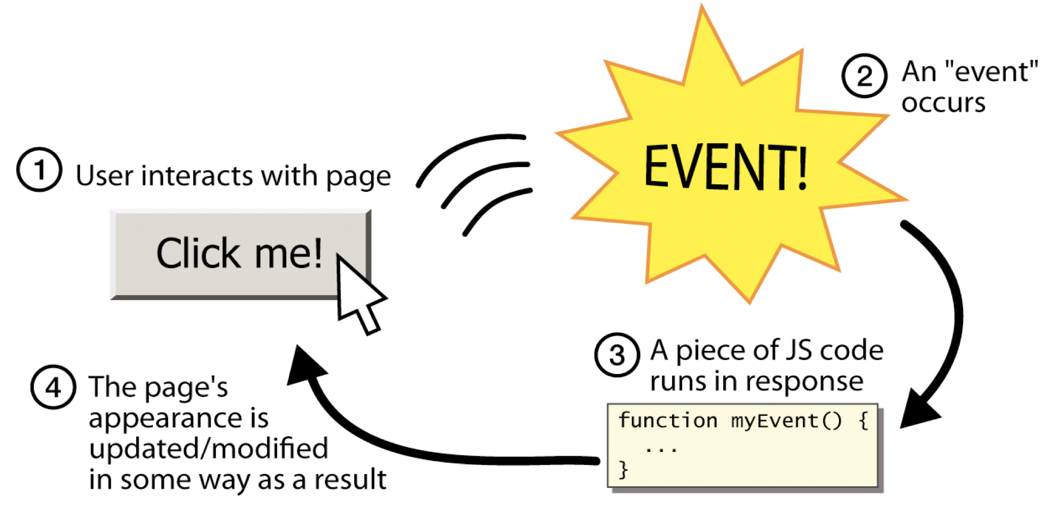
Event Handling

Slide 29
Supported Events
Mouse Events
onClick, onContextMenu, onDoubleClick
onDrag, onDragEnd, onDragEnter, onDragExit
onDragLeave, onDragOver, onDragStart, onDrop
onMouseDown, onMouseEnter, onMouseLeave
onMouseMove, onMouseOut, onMouseOver, onMouseUp
Keyboard Events
onKeyDown, onKeyPress, onKeyUp
Form Events
onChange, onInput, onInvalid,,onReset, onSubmit

Slide 30
Supported Events
Focus Events
onFocus, onBlur
Touch Events
onTouchCancel, onTouchEnd, onTouchMove, onTouchStart
UI Events
onScroll
Wheel Events
onWheel
Media Events
onAbort, onCanPlay, onCanPlayThrough,onDurationChange
onLoadedData, onLoadedMetadata, onLoadStart, onPause, onPlay, onPlaying, onProgress

Slide 31
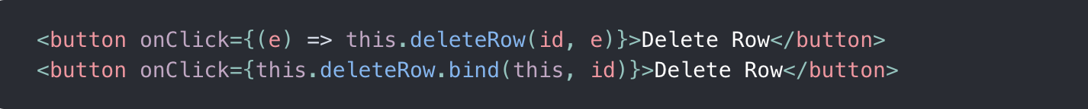
Passing Arguments to Event Handlers
Inside a loop, it is common to want to pass an extra parameter to an event handler. For example, if id is the row ID, either of the following would work,
In both cases, the e argument representing the React event

Slide 32
Props:
“Props” is a special keyword in React, which stands for properties and is being used for passing data from one component to another.
Prop is an Object
The data with props are being passed in a unidirectional flow. (one way from parent to child)
The props data is read-only, which means that data coming from the parent should not be changed by child components.

Slide 33
Class Component (Stateful)
It is regular ES6 classes that extends component class form react library
Also known as “stateful” components because they implement logic and state.
It must have render() method returning html
It has complex UI Logic
We need to pass props to class components and access them with this.props

Slide 34
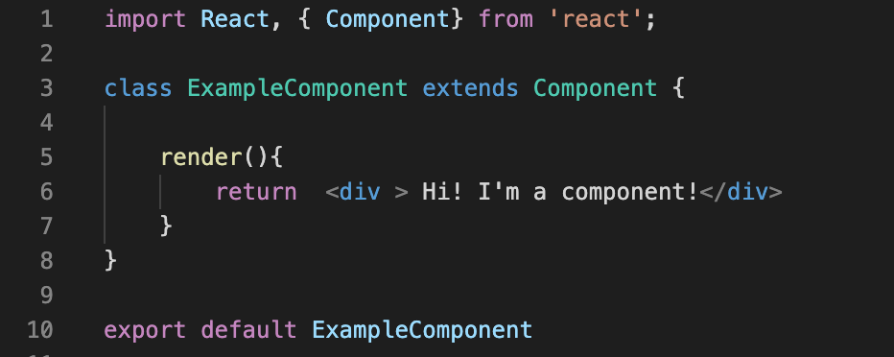
Code Snippet

Slide 35
“this” keyword in JavaScript
The JavaScript this Keyword, refers to the object it belongs to. The value of this is determined by how a function is called (runtime binding).
Global context:
In the global execution context (outside of any function), this refers to the global object.
In global context, the this will point to window object.

Slide 36
Function context:
Method
Function
Constructor Function
Class context
The behavior of this in classes and functions is similar, since classes are functions under the hood.
Derived classes
Unlike base class constructors, derived constructors have no initial this binding. Calling super() creates a this binding within the constructor.

Slide 37
What is state?
React has another special built-in object called "state".
It allows components to create and manage their own data.
So unlike props, components cannot pass data with state, but they can create and manage it internally.
State should not be modified directly, but it can be modified with a special method called "setState( )"
State should be defined in the Constructor method.

Slide 38
What happens when state changes?
A change in the state happens based on user-input, triggering an event, and so on.
Also, React components (with state) are rendered based on the data in the state.
So when state changes, React gets informed and immediately re-renders the DOM – not the whole DOM, but only the component with the updated state. This is one of the reasons why React is fast.
The setState( ) method triggers the re-rendering process for the updated parts.

Slide 39
Conditional Rendering
The conditional based view rendering based on the state of application.
Element Variables - { variable }
Inline If with Logical && Operator - { condition && JSX }
Inline If-Else with Conditional Operator - { condition ? JSX 1 : JSX 2 }

Slide 40
Mutable vs Immutable
Mutable means “subject to change or alteration”
If an item is mutable, modifying the copy also modifies the original.
Immutable means “unalterable”
If it’s immutable, modifying the copy does not affect the original.

Slide 41
Spread Operator
The spread operator is a useful and quick syntax for adding items to arrays, combining arrays or objects.
It had syntax ... (triple dots)
The spread operator ( ... ) is useful for many different routine tasks in JavaScript, including the following,
Copying an array
Concatenating or combining arrays
Using an array as arguments
Adding an item to a list
Adding to state in React
Combining objects

Slide 42
Array Iteration Methods
Array.forEach()
The forEach() method calls a function (a callback function) once for each array element.
The callback function takes 3 arguments - value, index, array
Array.map()
The map() method creates a new array by performing a function on each array element.
The callback function takes 3 arguments - value, index, array
Array.filter()
The filter() method creates a new array with array elements that passes a test.
The callback function takes 3 arguments - value, index, array
Array.reduce()
The reduce() method runs a function on each array element to produce (reduce it to) a single value.
The callback function takes 4 arguments - previous value, current value, index, array

Slide 43
Lists and Keys
Transforming arrays into lists of elements is nearly identical.
Keys help React identify which items have changed, are added, or are removed. Keys should be given to the elements inside the array to give the elements .

Slide 44
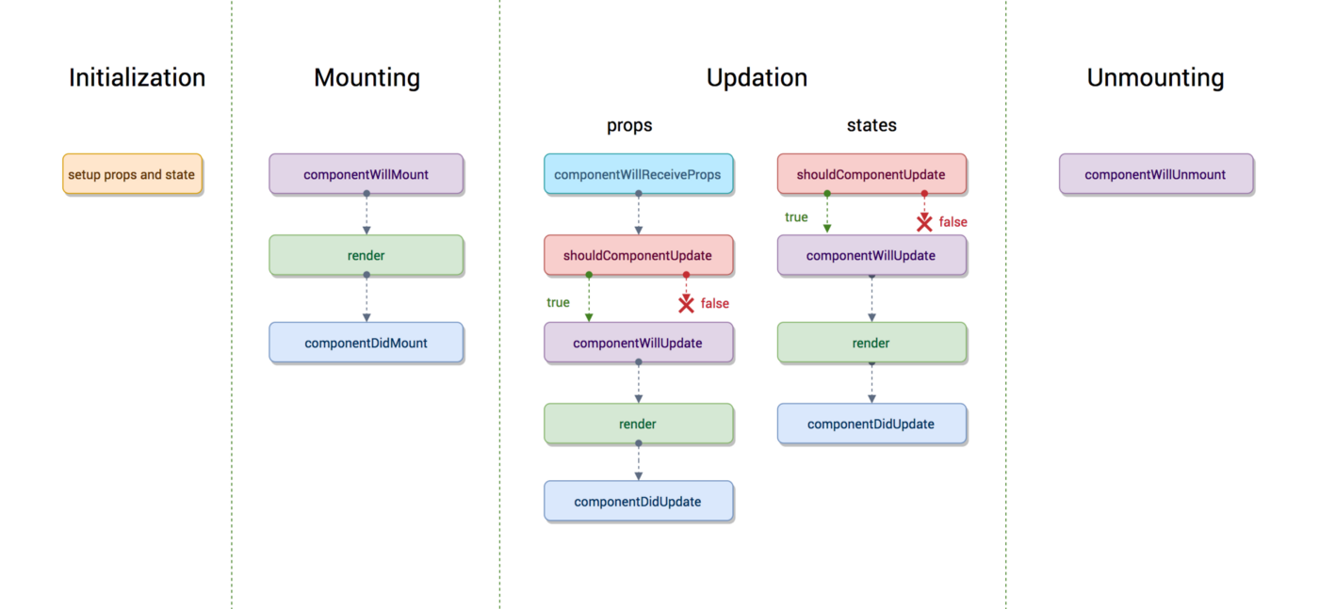
React LifeCycle

Slide 45
Live Project - 1

Slide 46
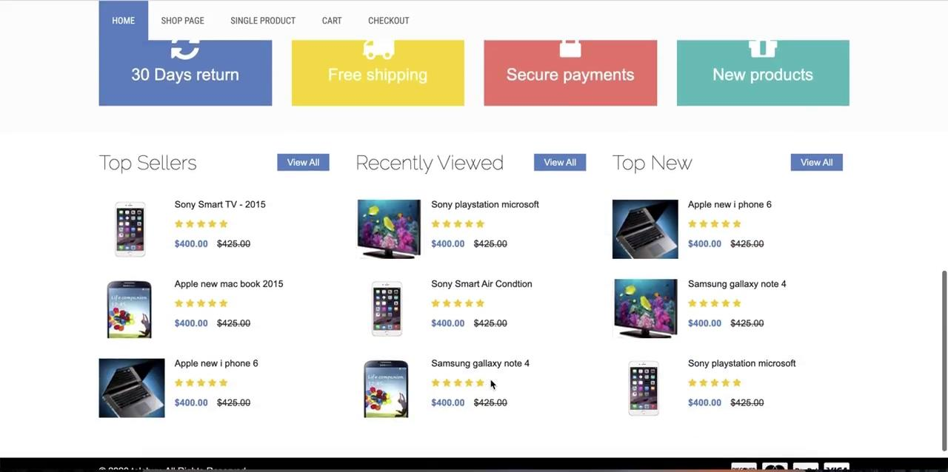
https://github.com/karthickvelebuy-html-templatekumar/t

Slide 47
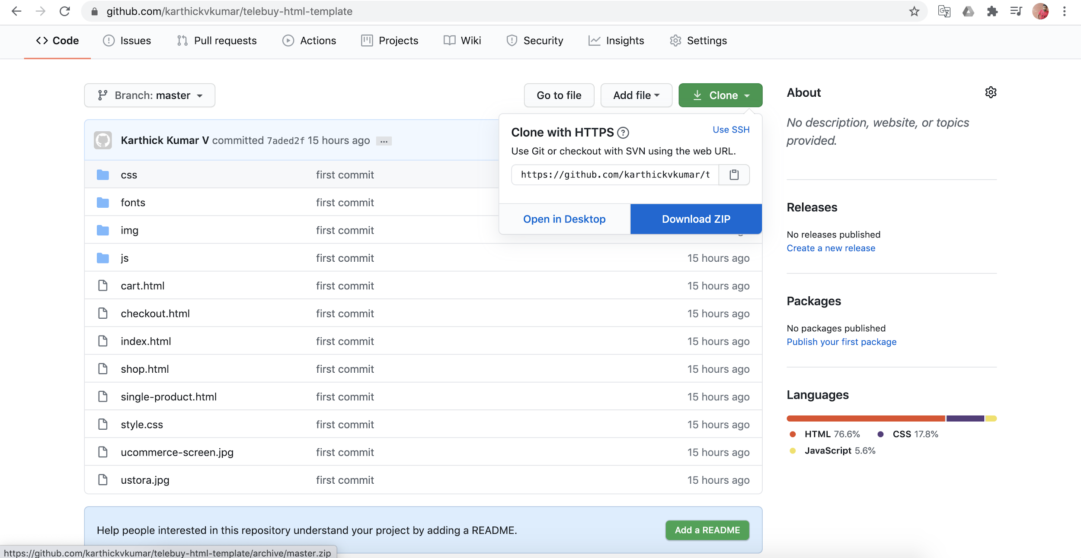
Click Clone
Download as ZIP file

Slide 48
Thinking in React Way

Slide 49
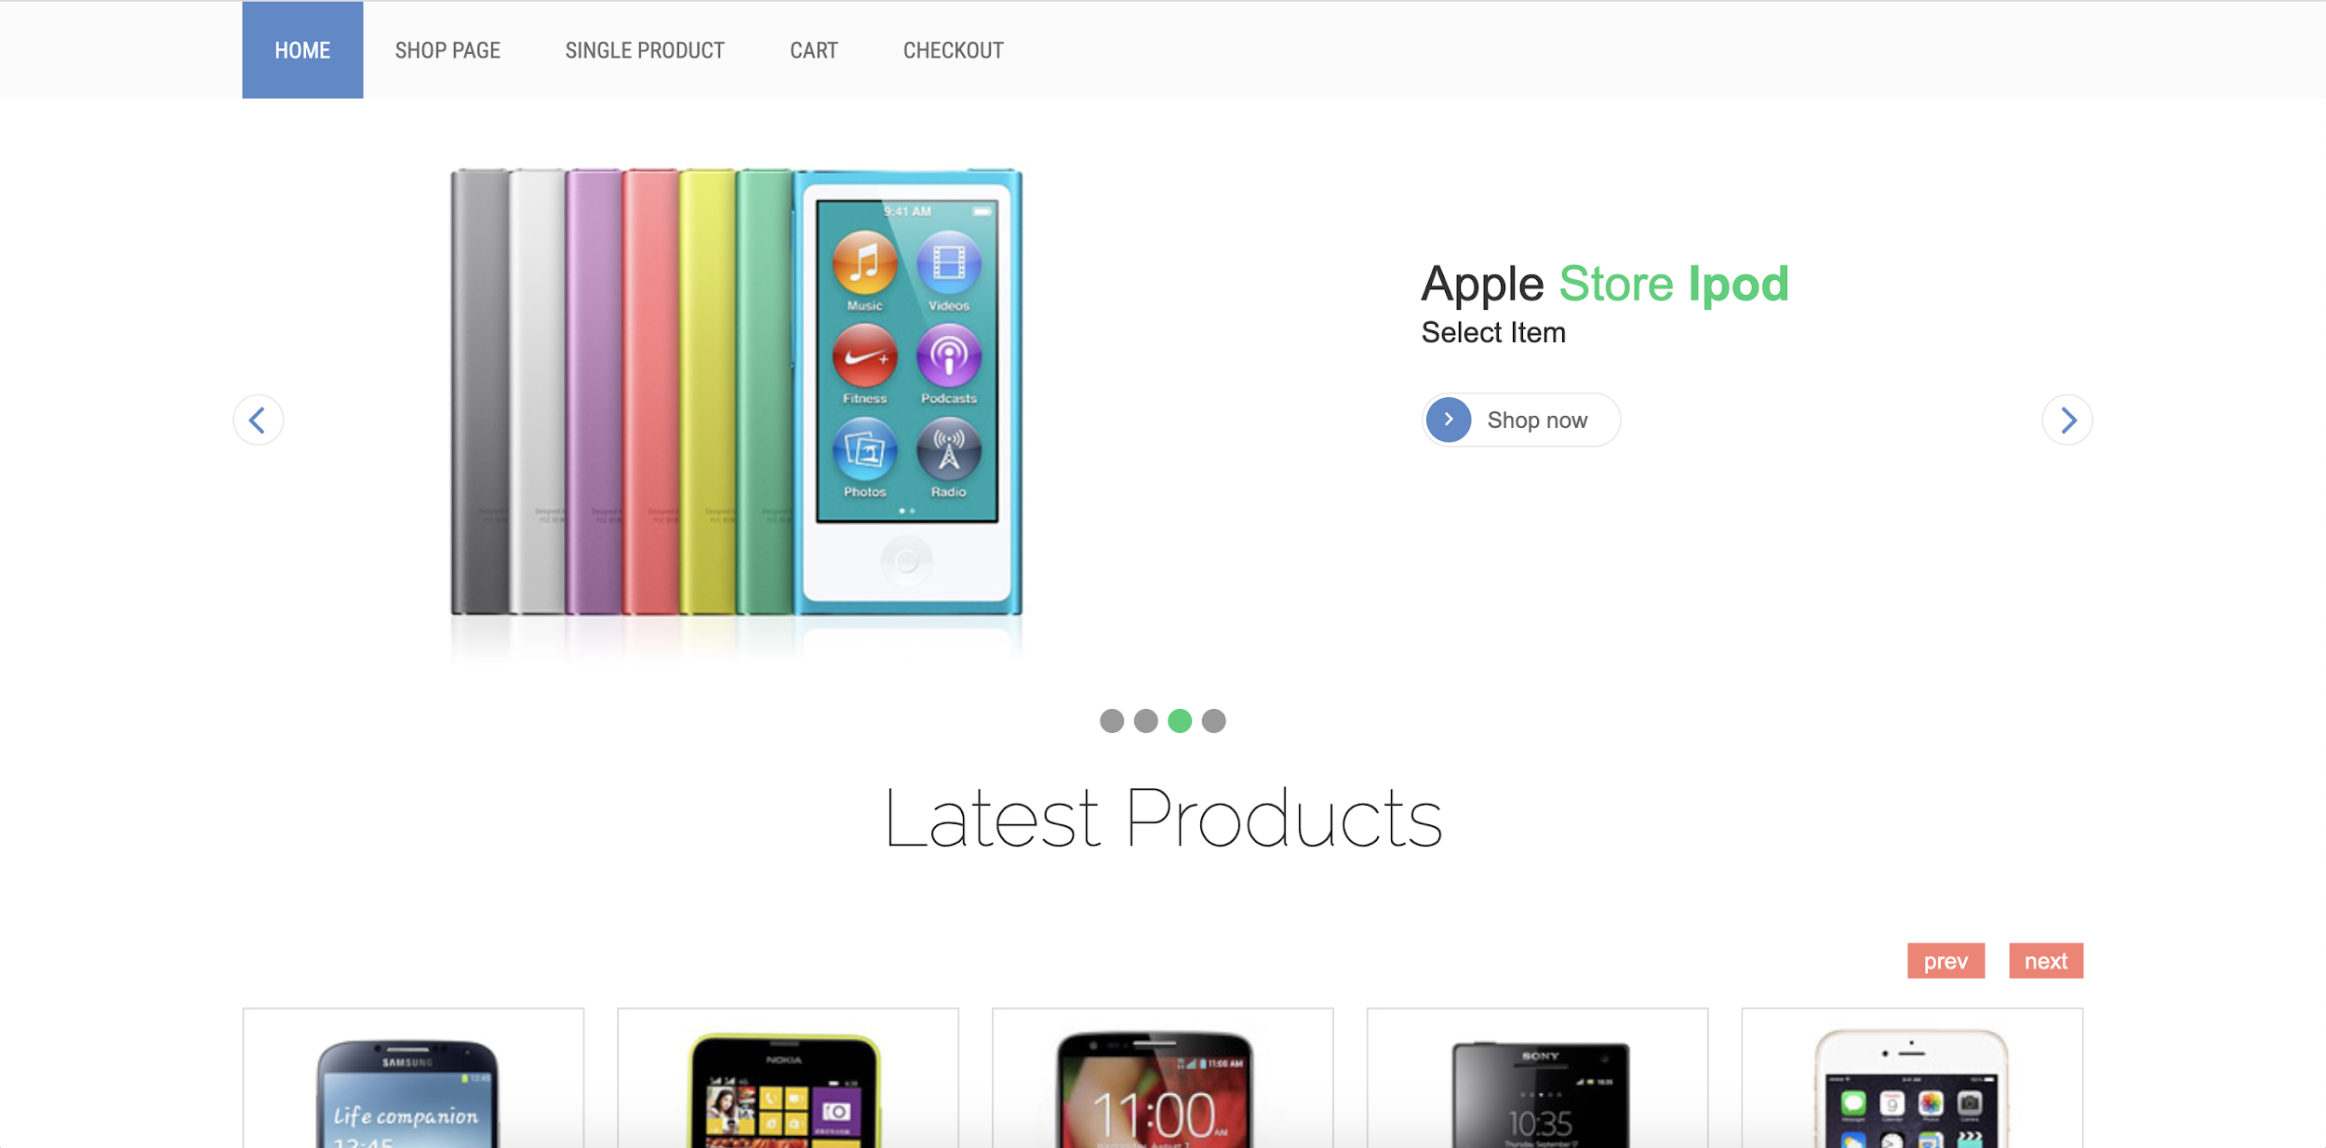
Header - Navigation Bar
Image Slider - Carousel

Slide 50
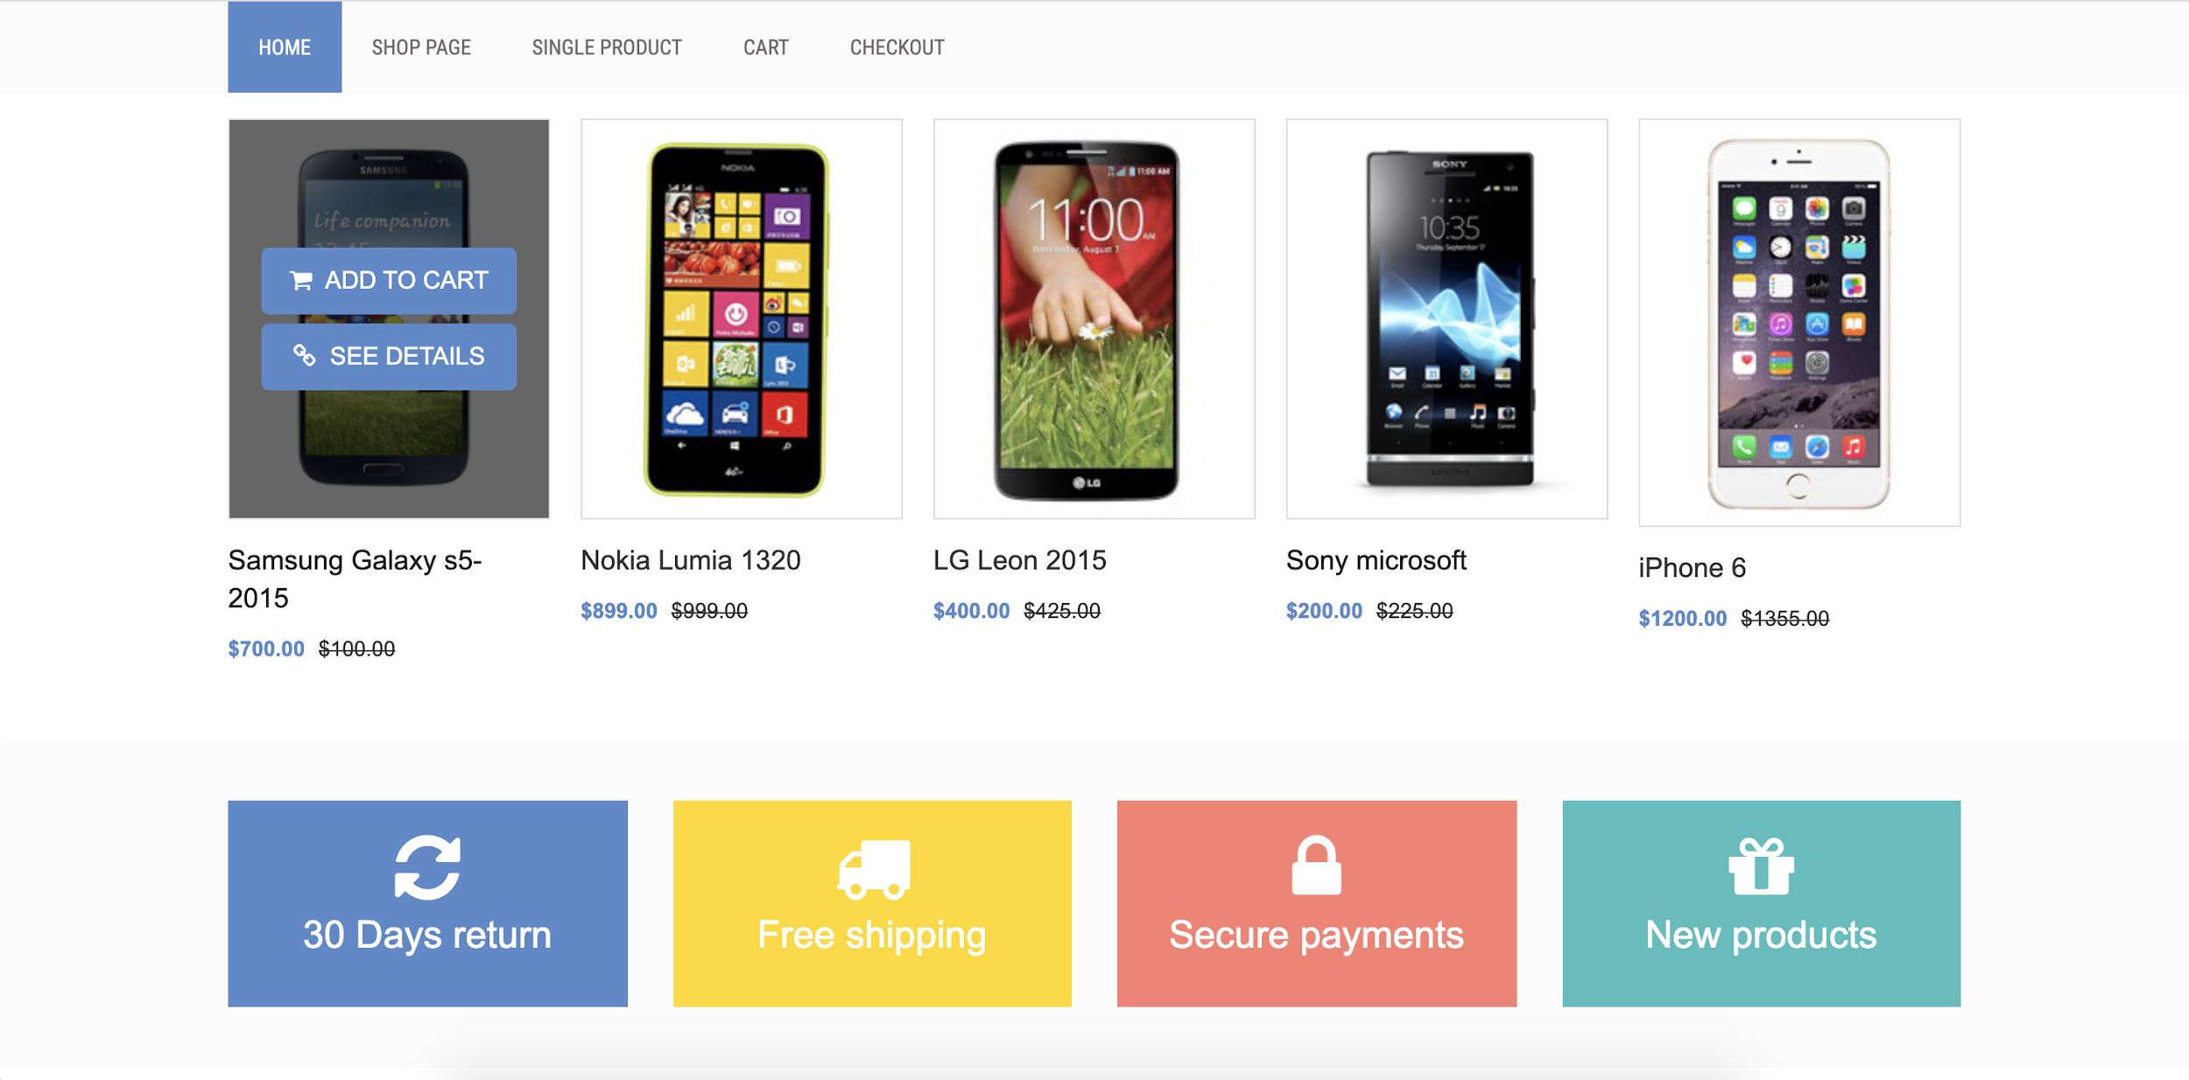
Product Component
Product List Component
Product Info Component

Slide 51
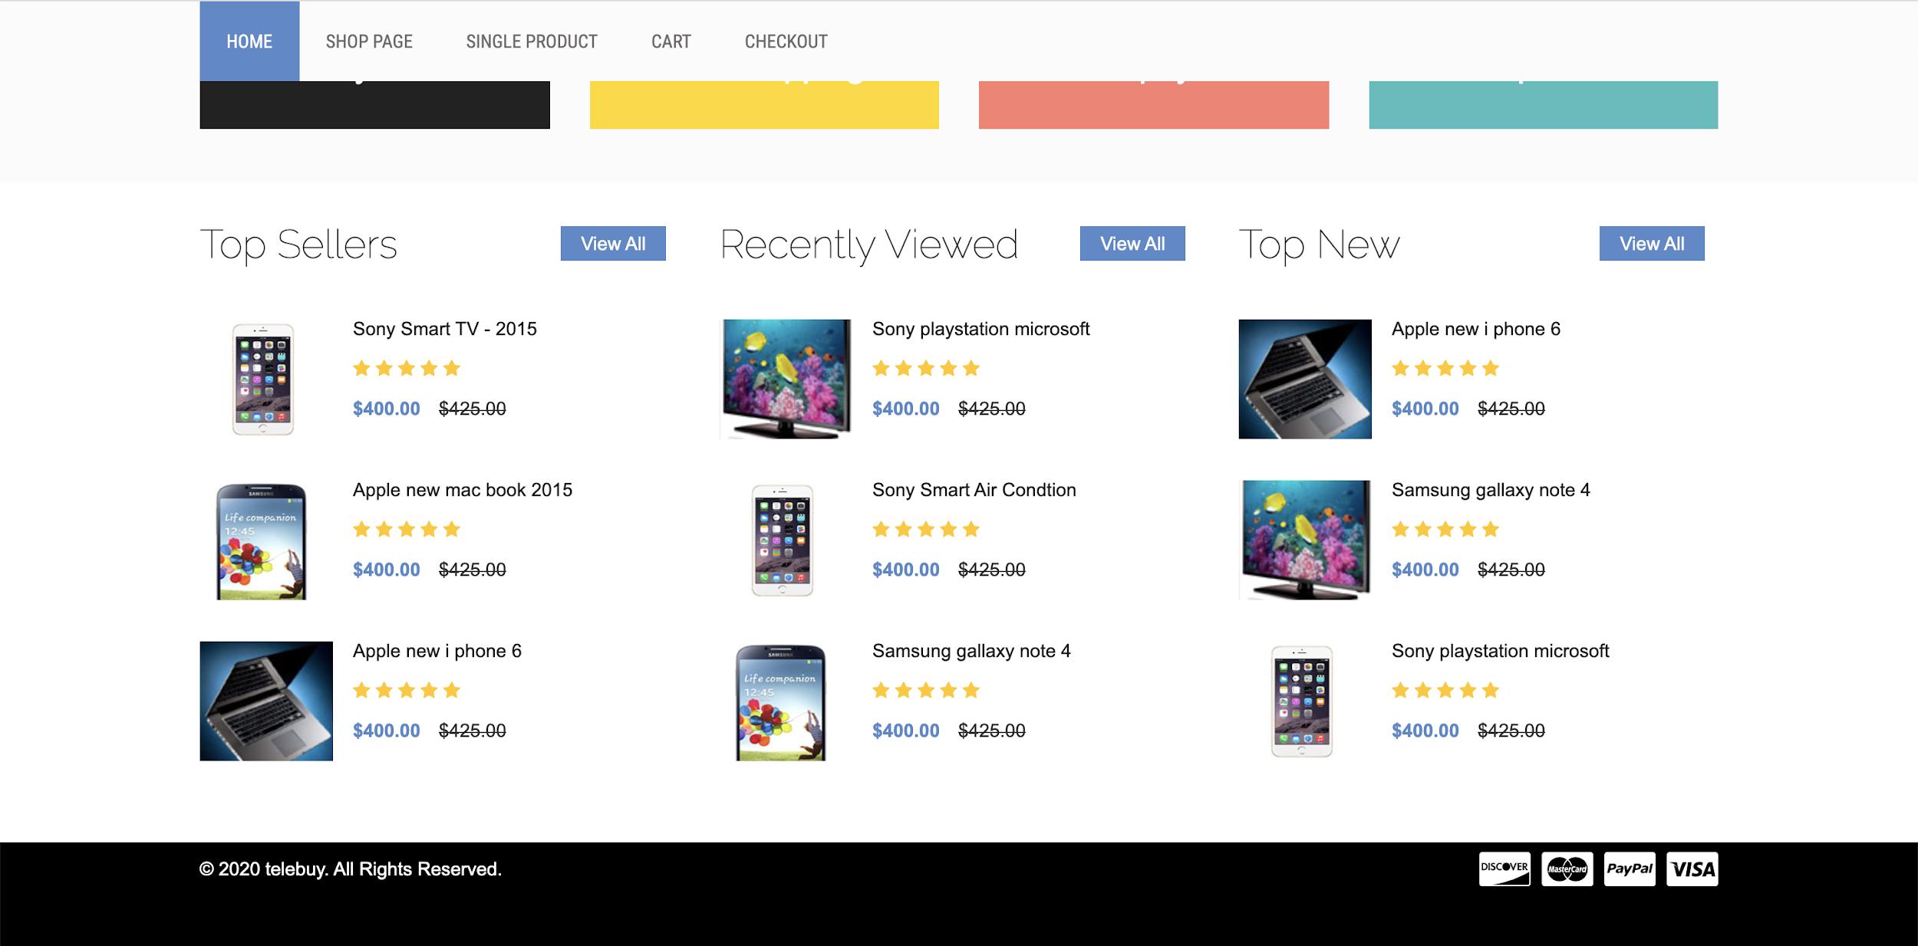
Product Preview Component
Footer Componenet

Slide 52
Home.js - Main js file to import all components
Page Folder
<HeaderComponent> </HeaderComponent>
<ImageSliderComponenet> </ImageSliderComponenet>
<ProductListComponent>
<ProductComponent></ProductComponent>
</ProductListComponent>
Components Folder
<ProductInfoComponenet> </ProductInfoComponenet>
<TopSellerBrandComponent>
<ProductPreviewComponent></ProductPreviewComponent>
</TopSellerBrandComponent>
<FooterComponent> </FooterComponent>

Slide 53
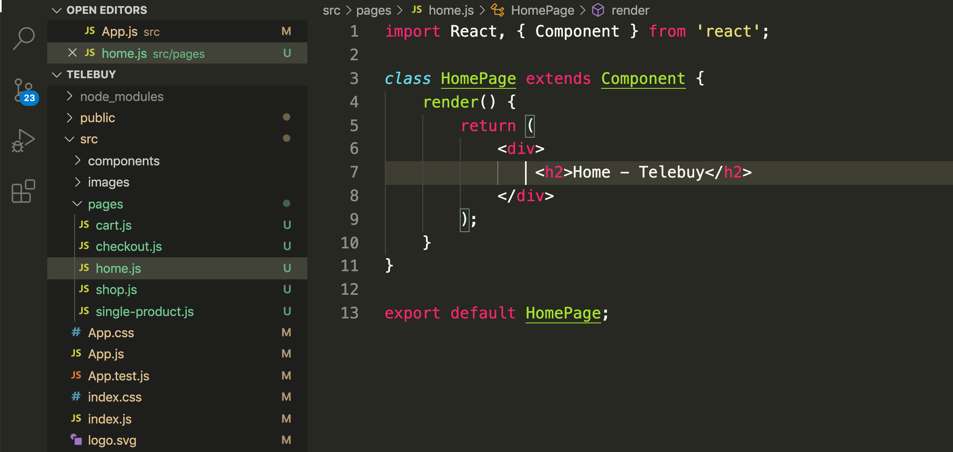
Create new files
Create new React Componenet

Slide 54
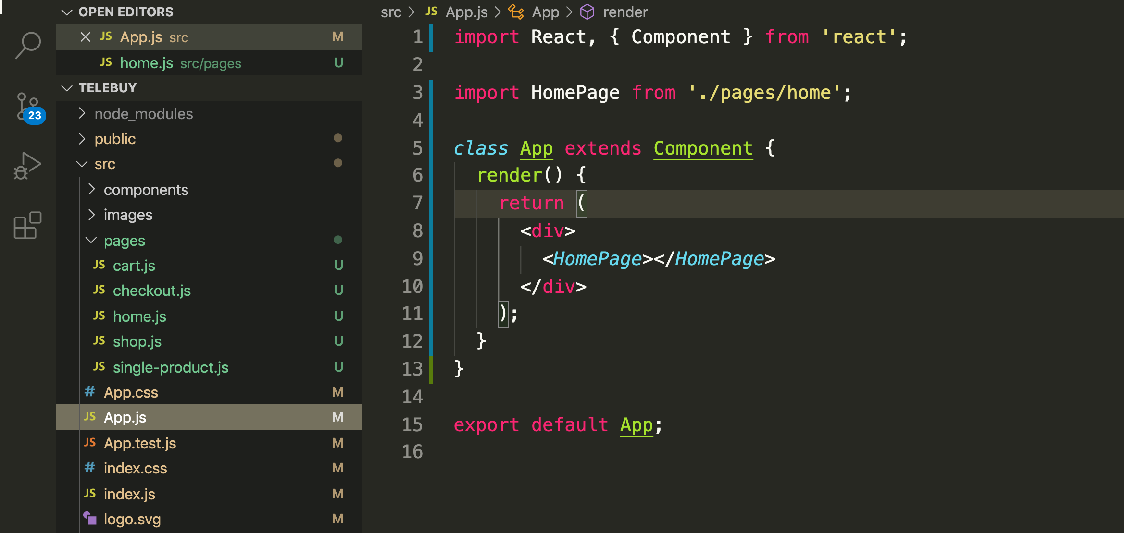
Modify the App.js and import HomePage

Slide 55
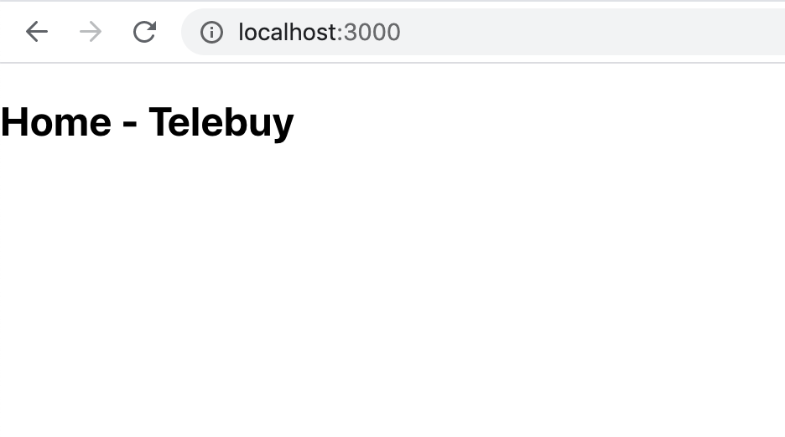

Slide 56
React JS Plugins

Slide 57
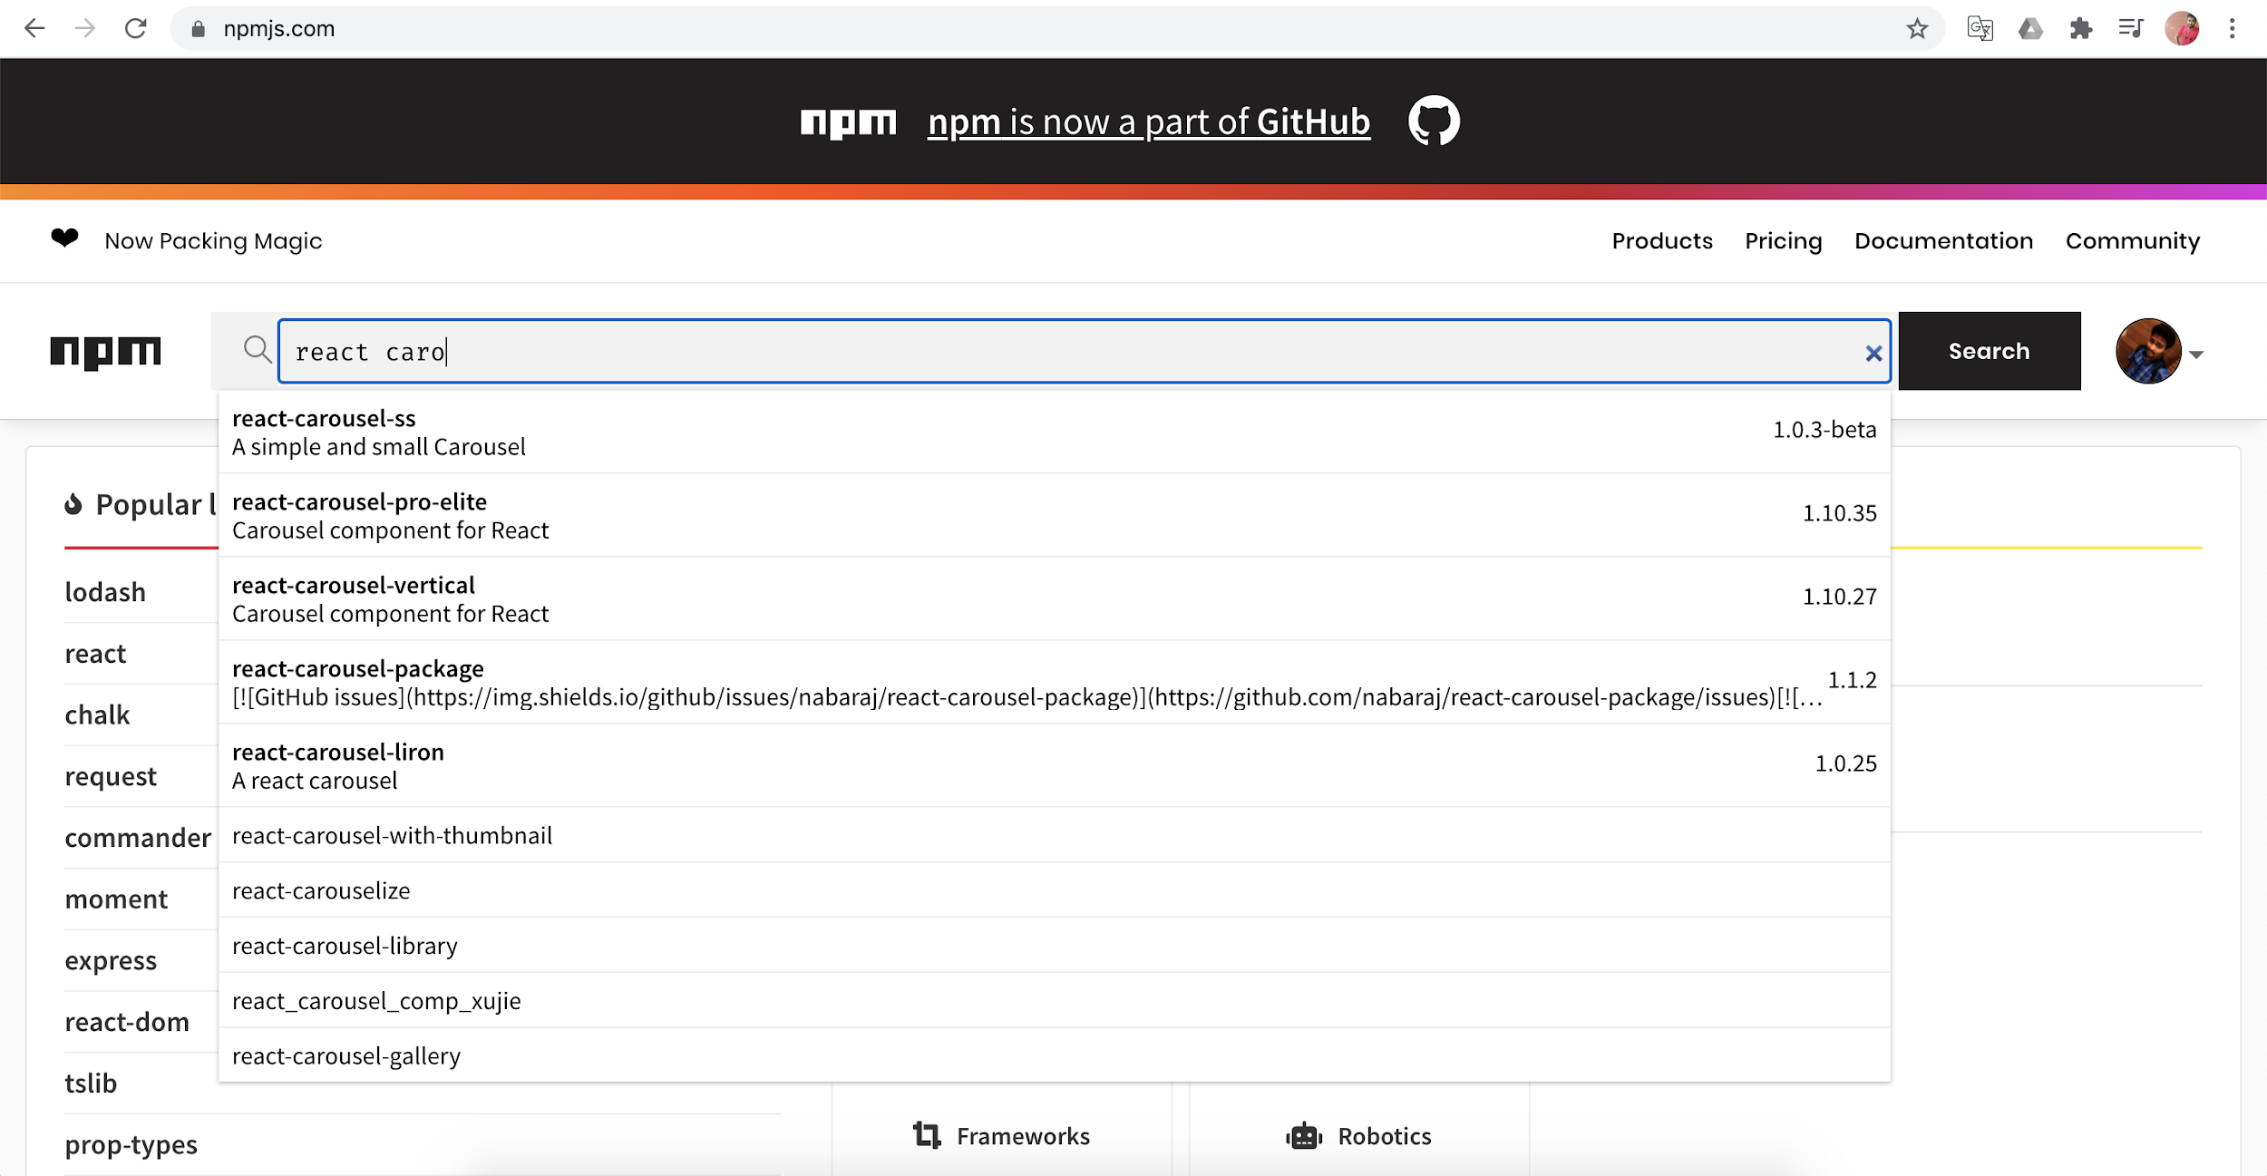
https://npmjs.com - React Plugins

Slide 58
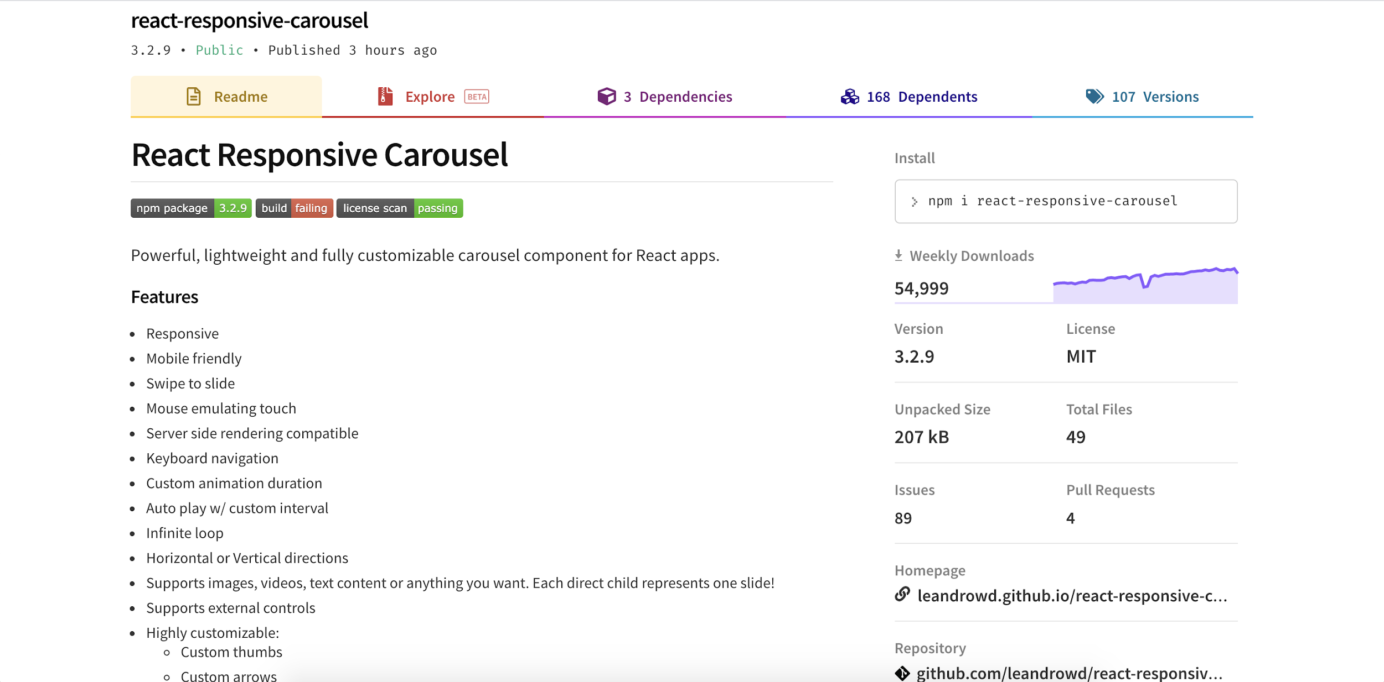
Installation Command
Check popularity
Check License
Check its homepage
Check its Features, demo and support
Options for customization

Slide 59
Plugins used in HTML Template
npm install bootstrap --save
npm install jquery --save (should not use jQuery in react app)
npm install font-awesome --save
npm install react-responsive-carousel --save
Install the dependencies into the project via terminal

Slide 60
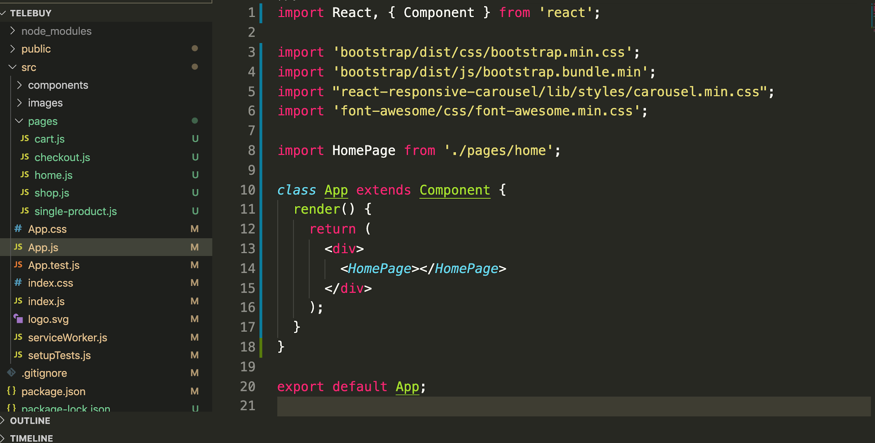
Plugin code
Importing the plugins

Slide 61
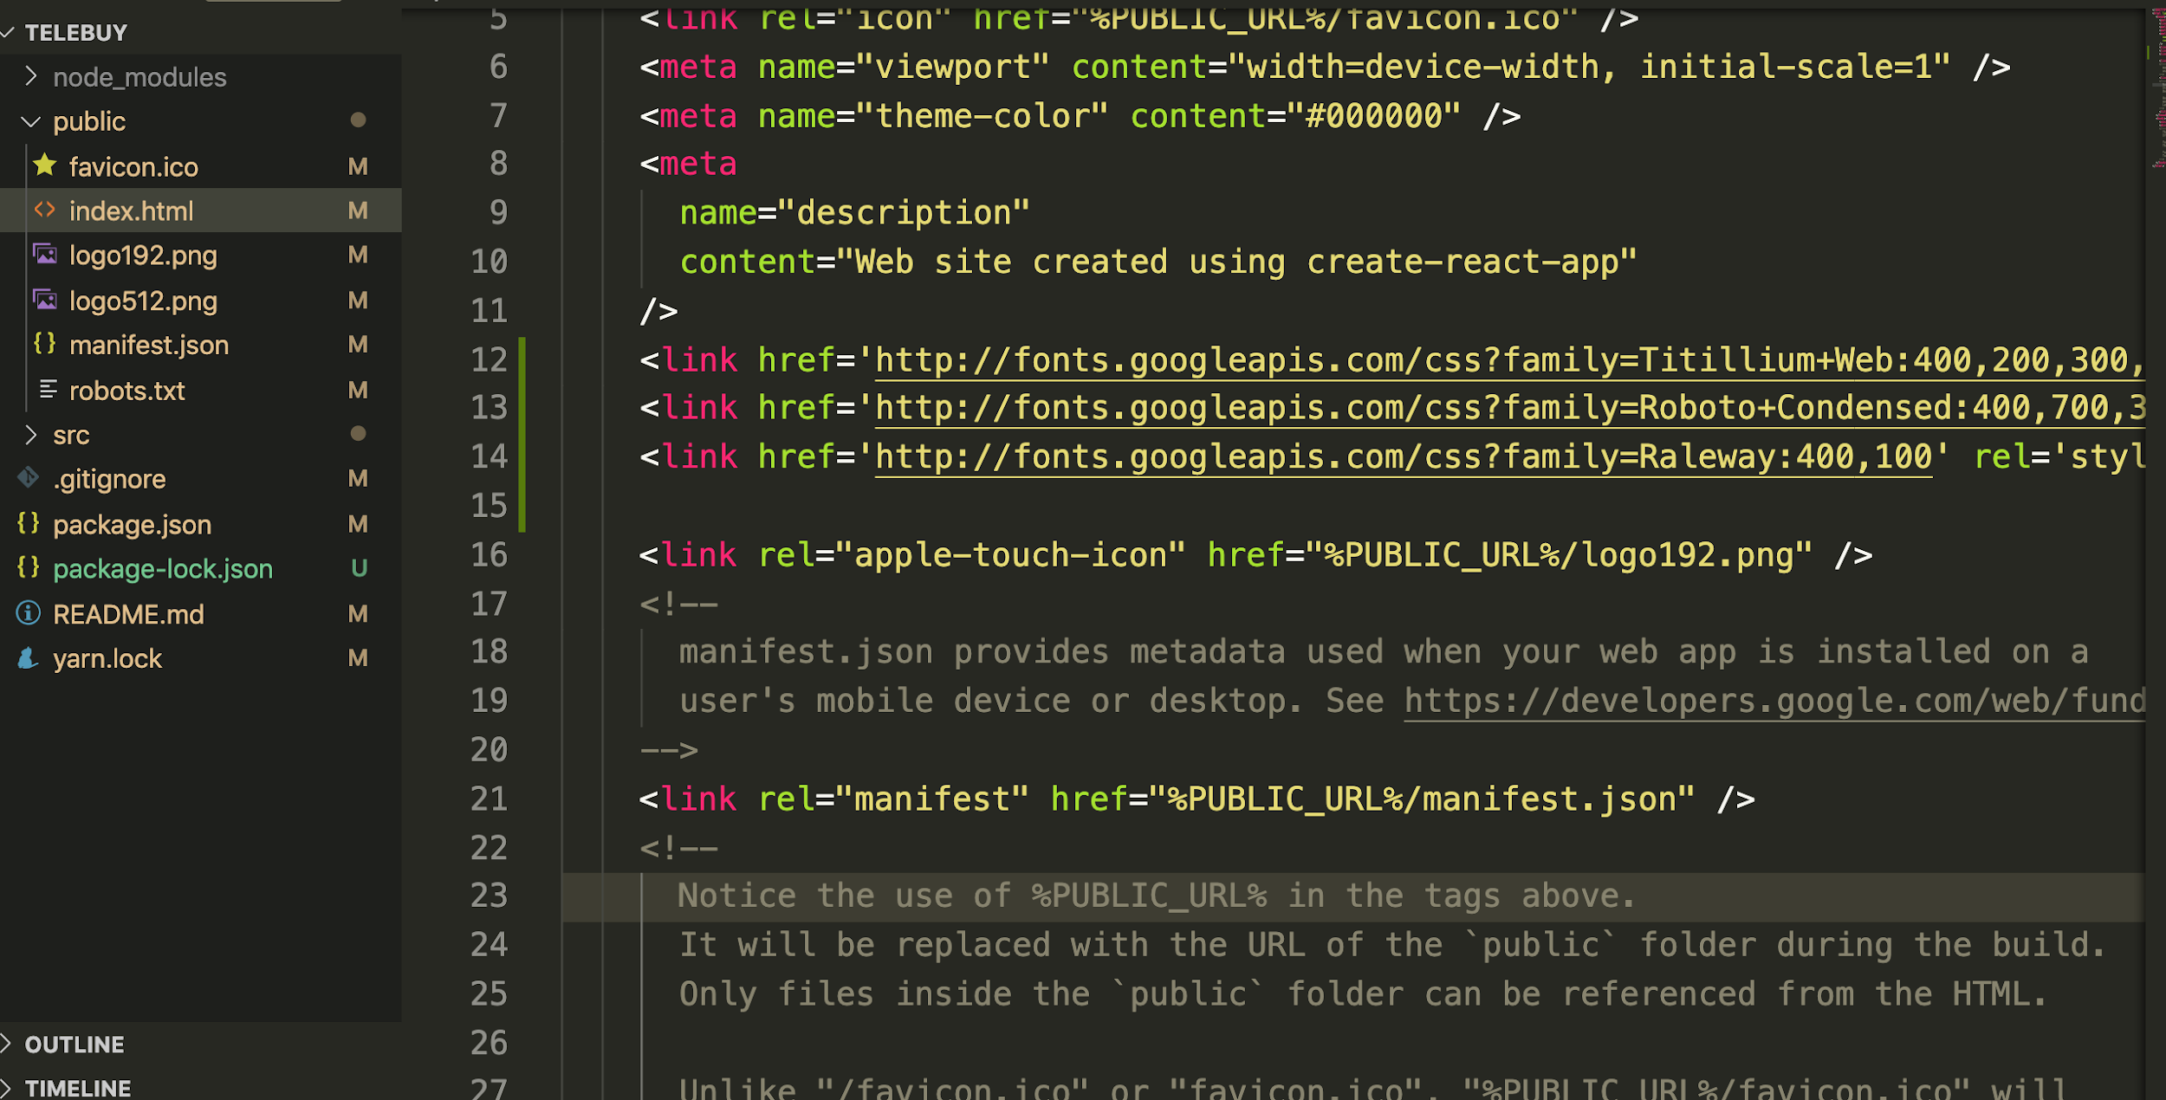
Add Google font

Slide 62
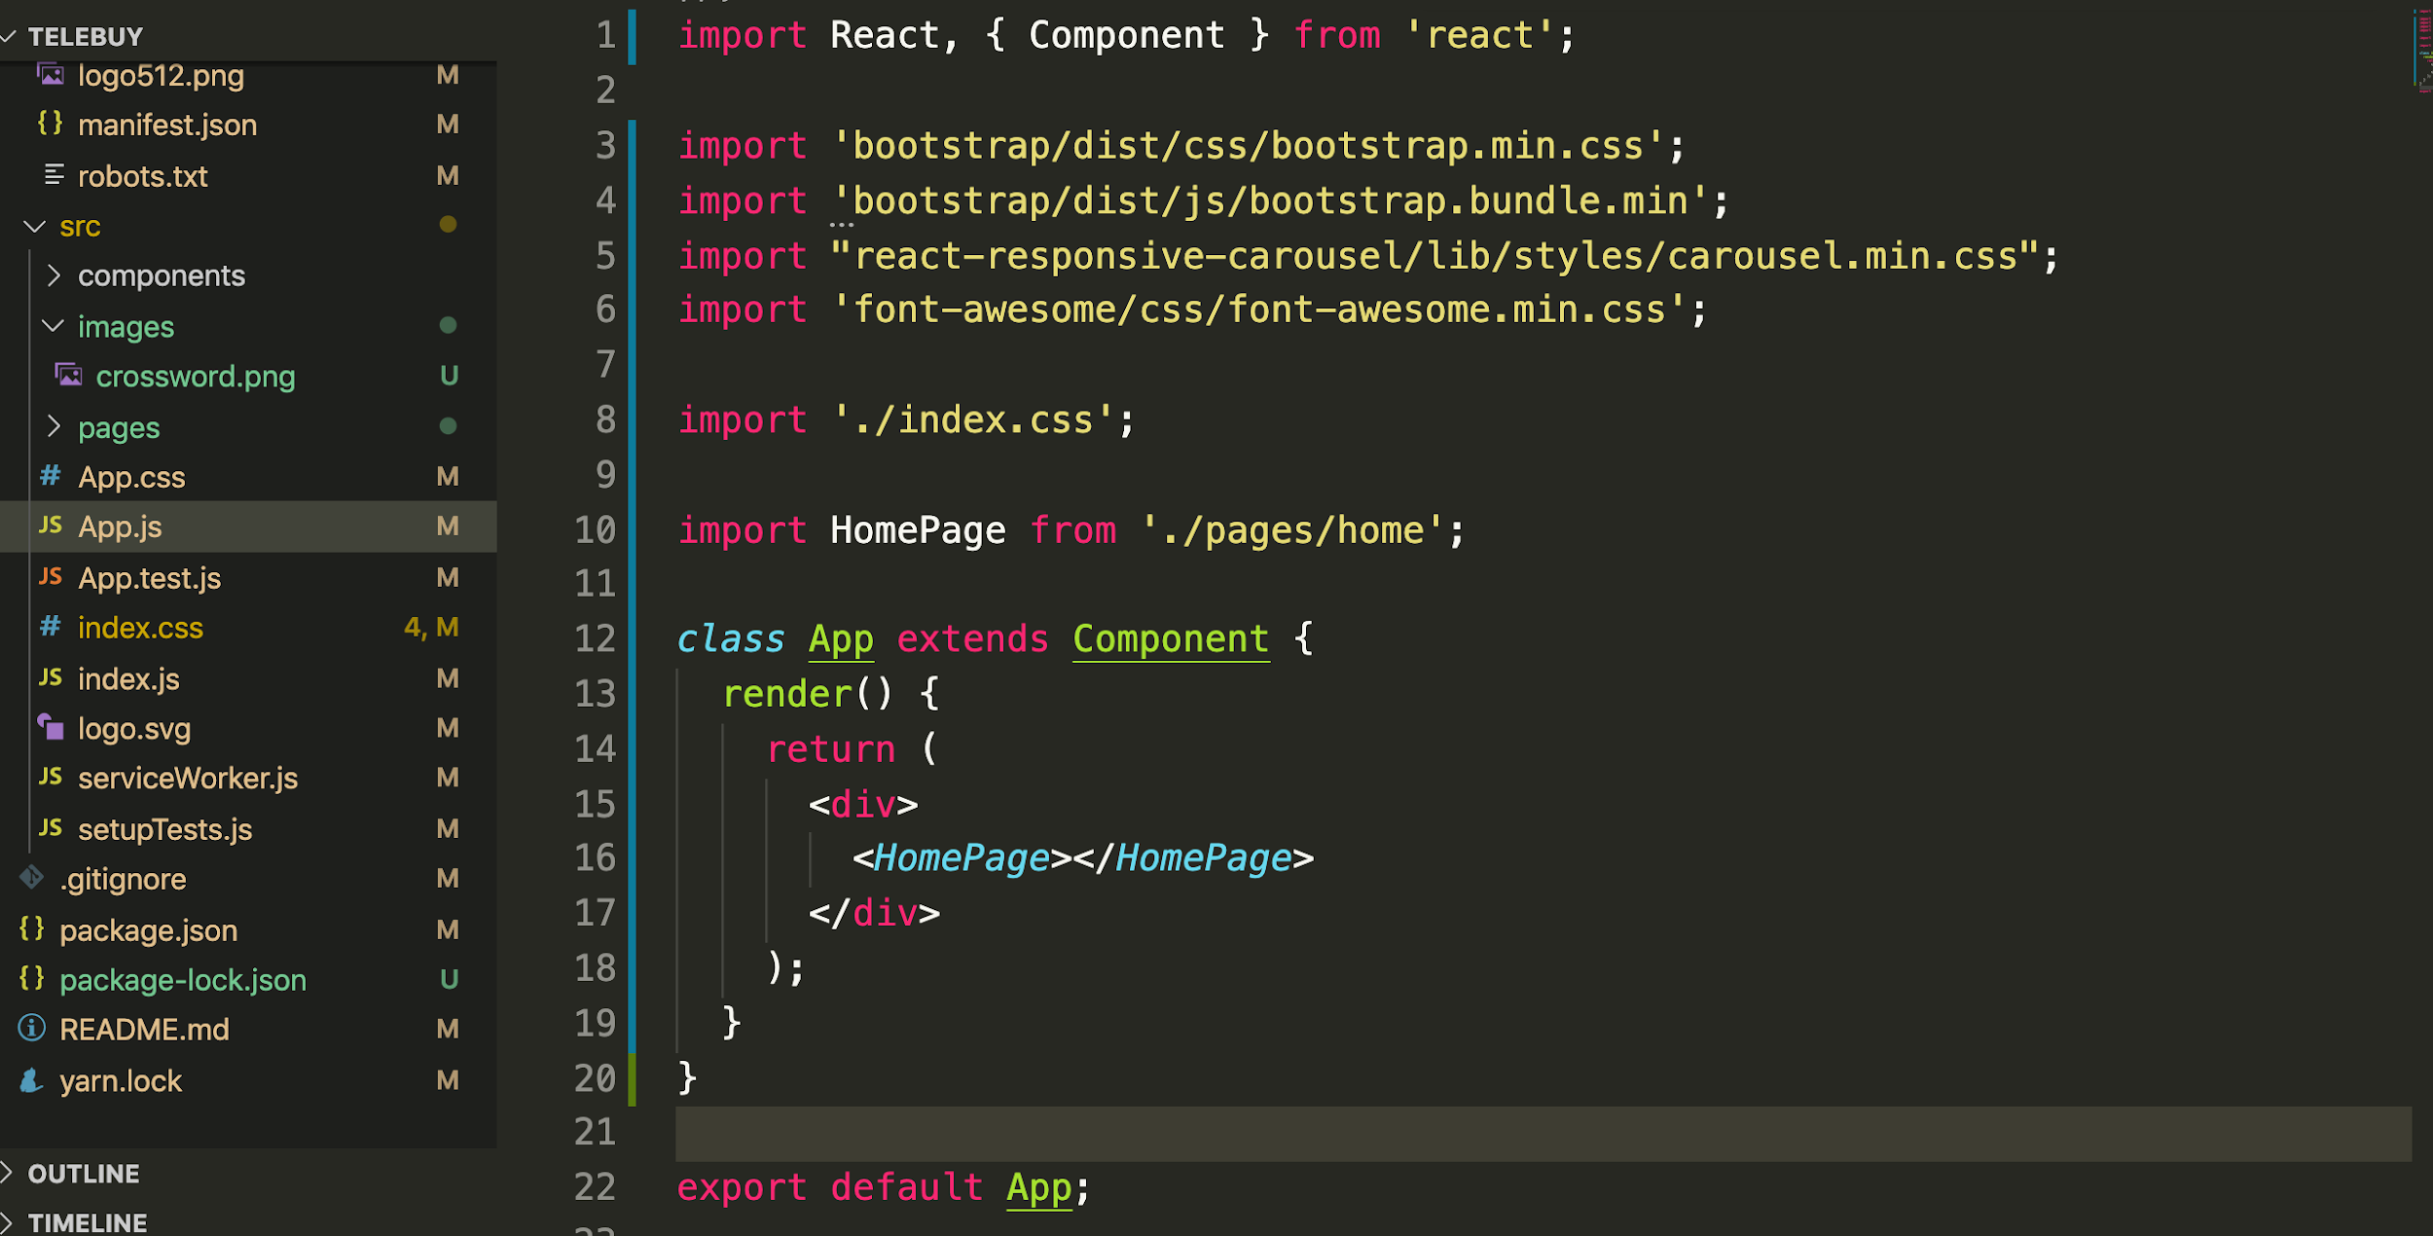
Importing css to react app
Moving the style from template to index.css

Slide 63
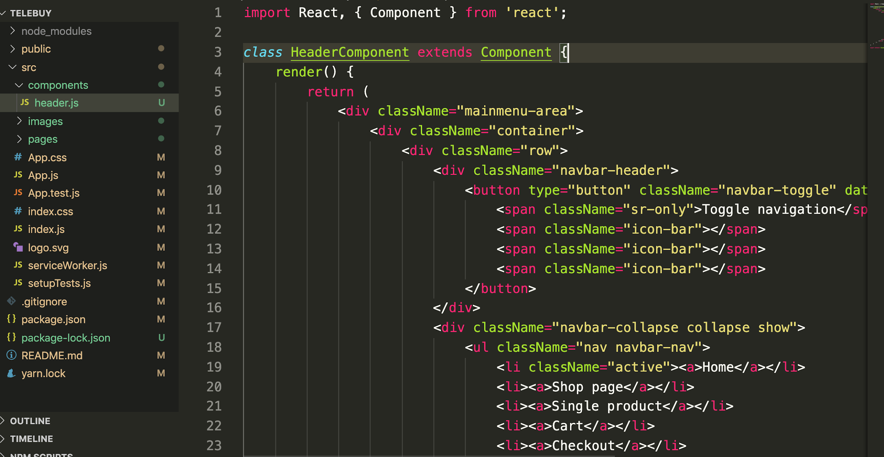
Coppied the header HTML code from the template

Slide 64
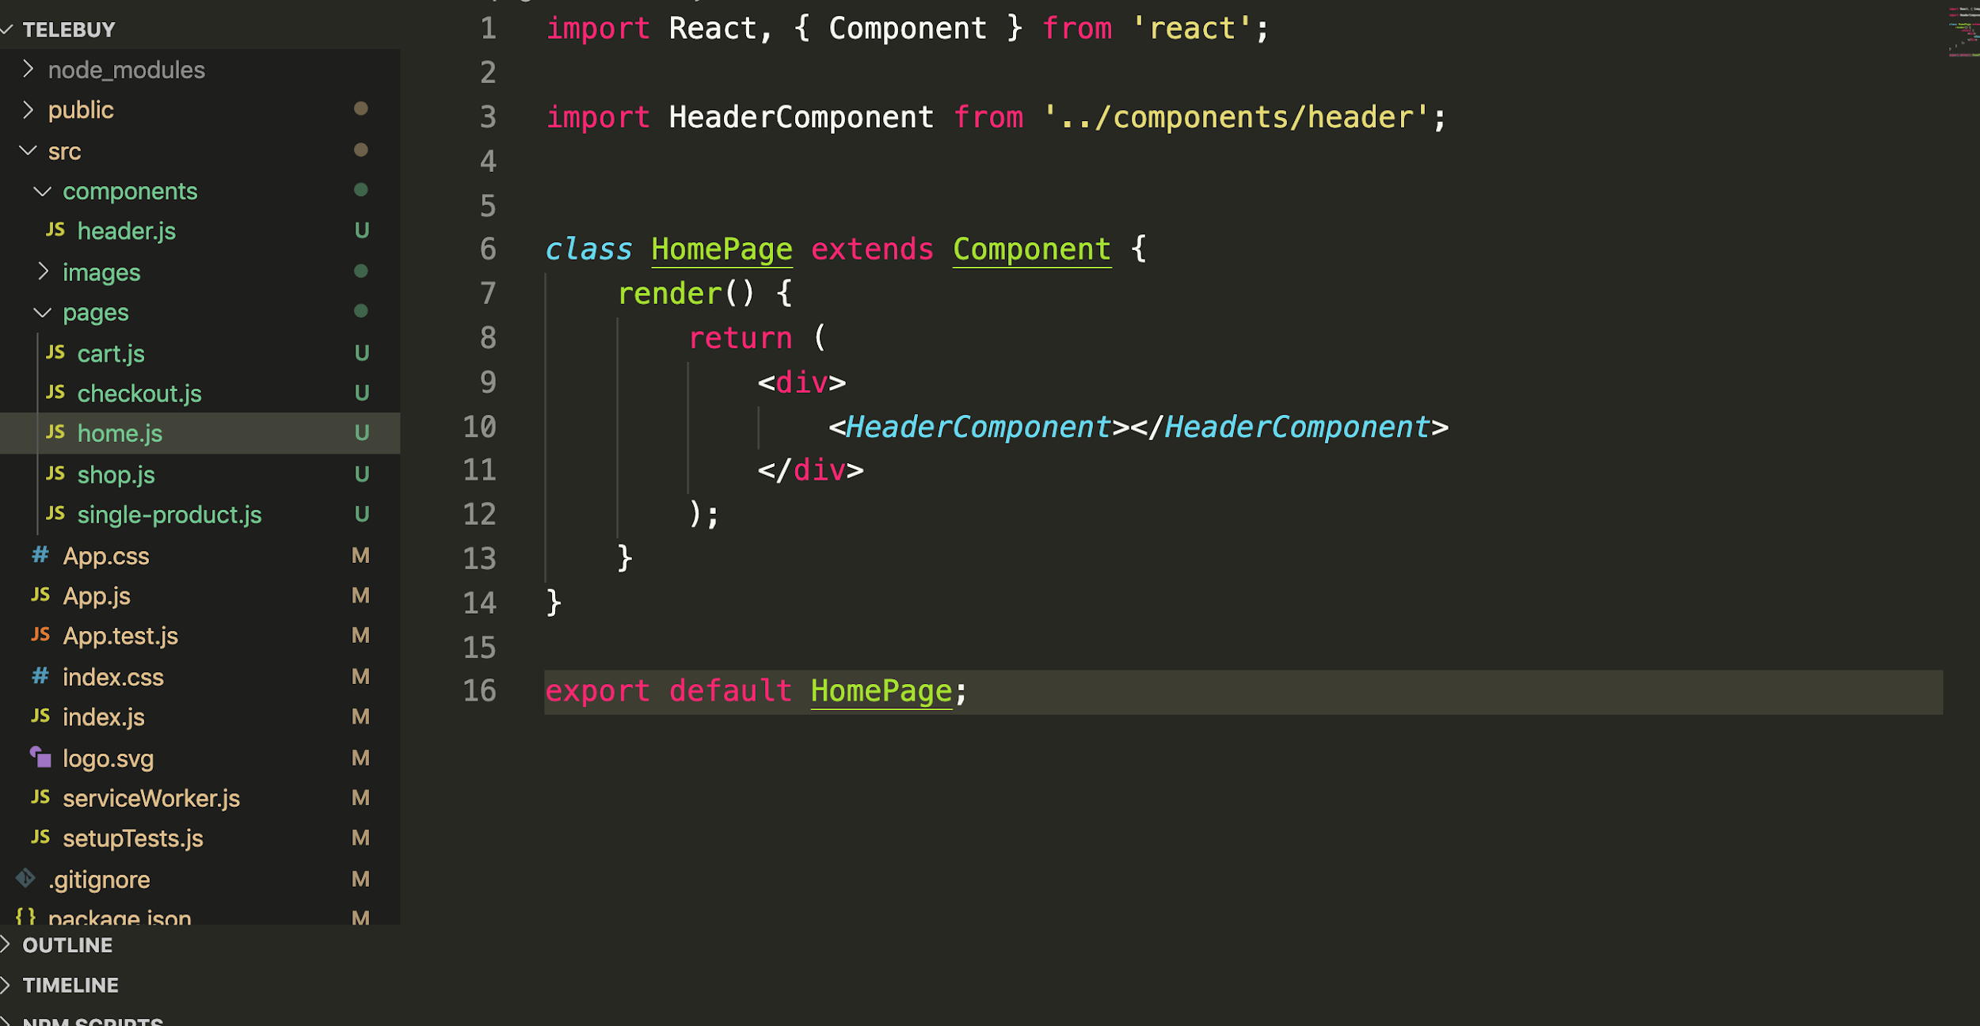
Imported the HeaderComponent and updated in render method

Slide 65
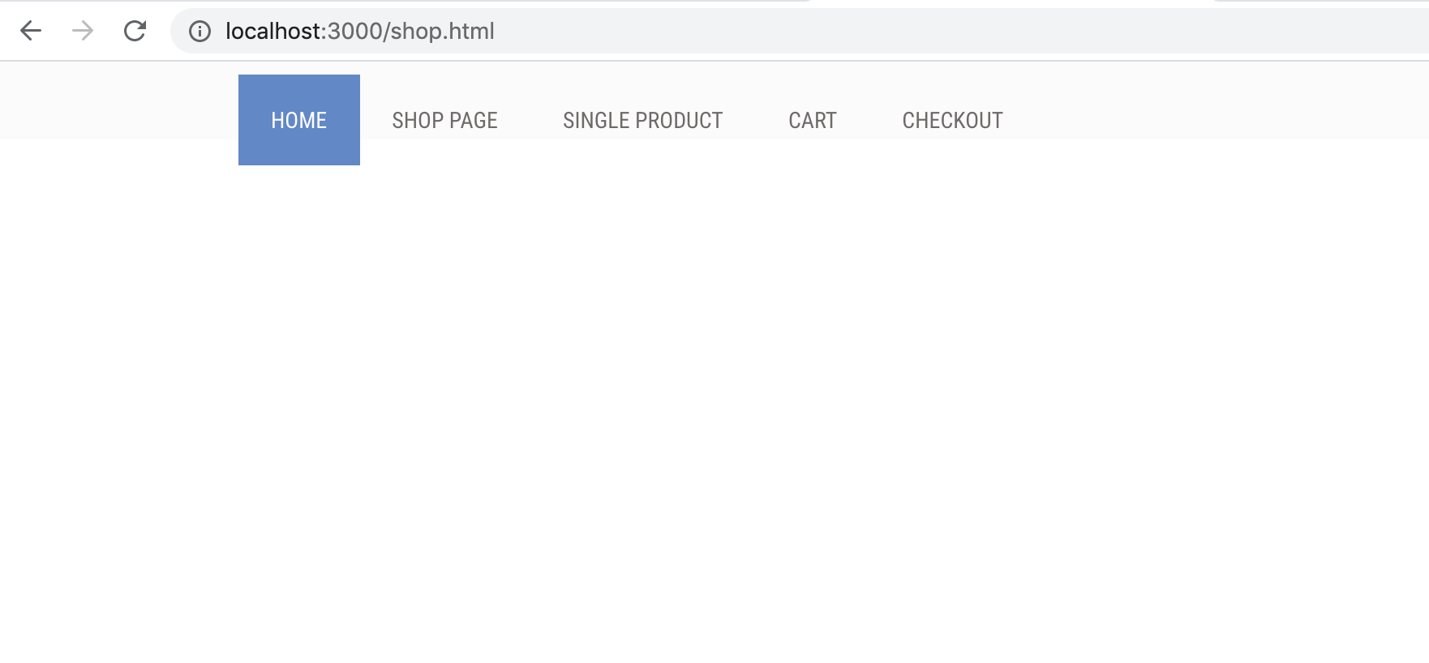

Slide 66
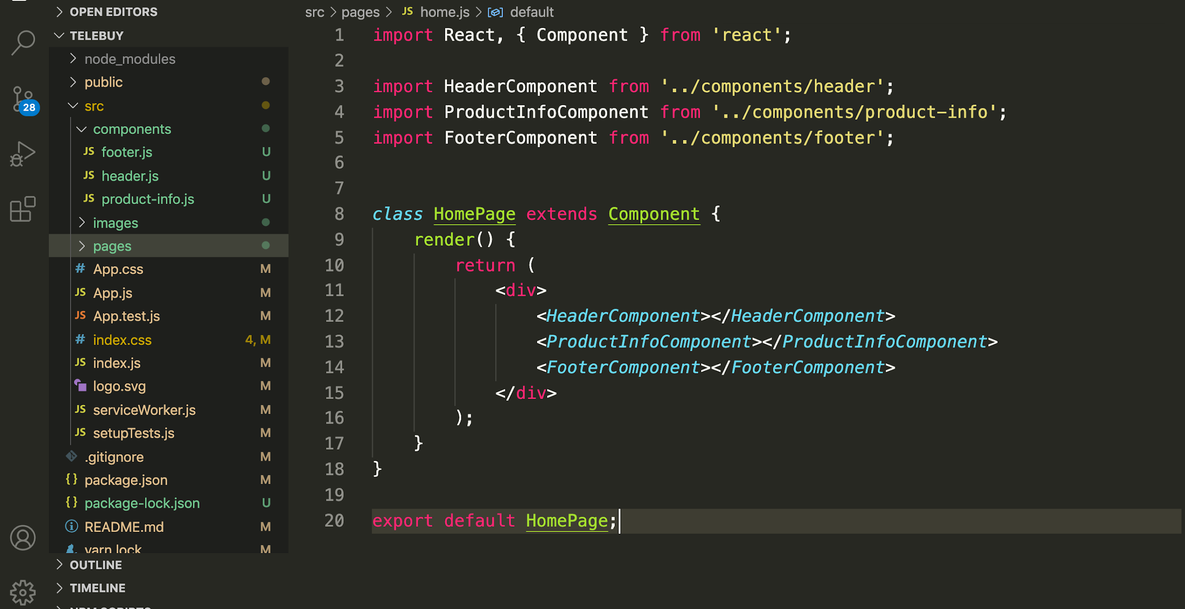

Slide 67
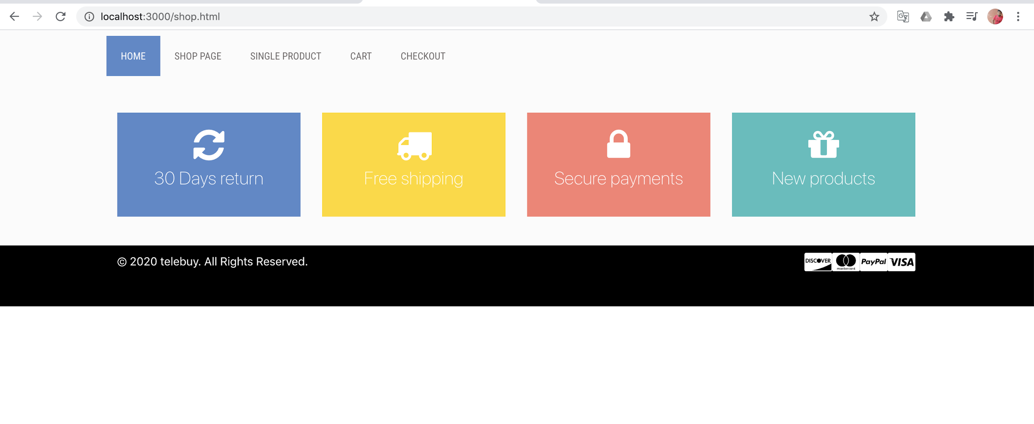

Slide 68
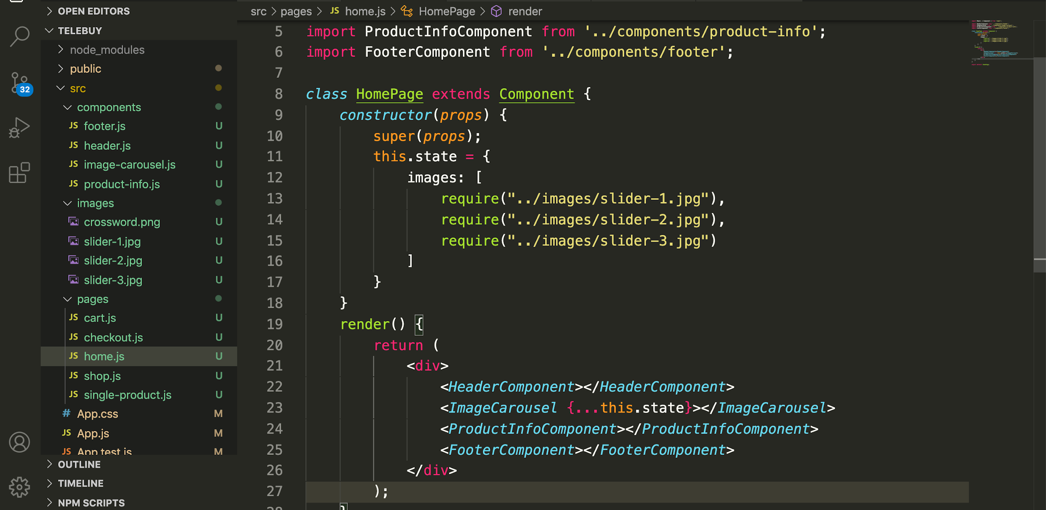
Loading image from local folder
Passing the image to ImageCarousel component

Slide 69
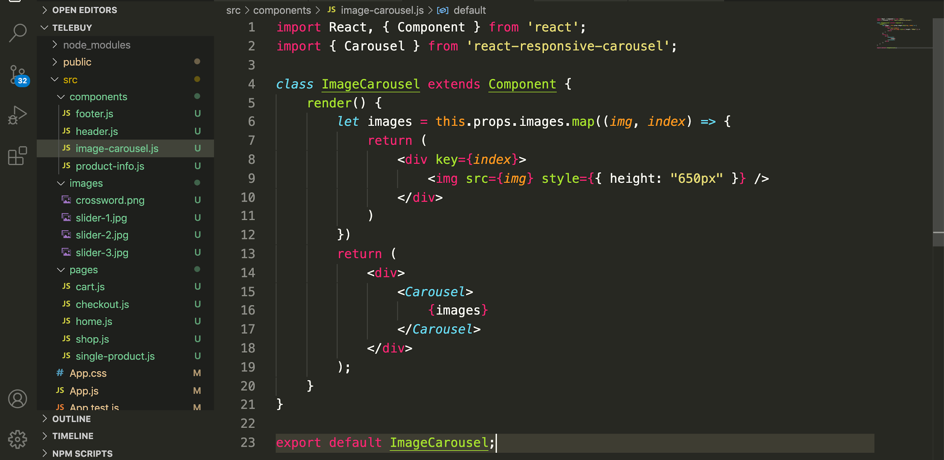
Importing carousel plugin
Iterating the image
Inline Styles

Slide 70
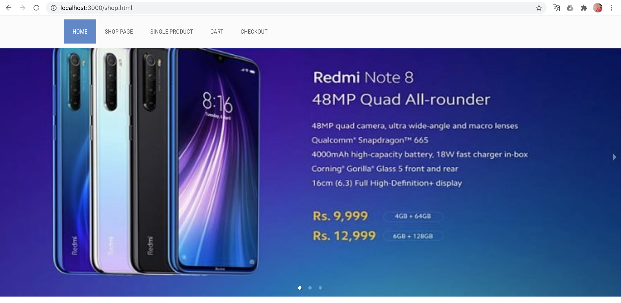

Slide 71
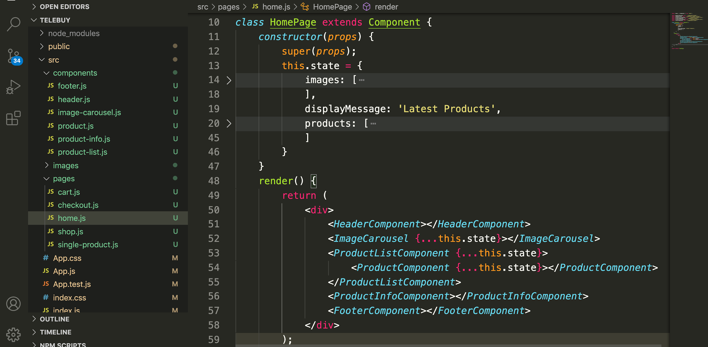

Slide 72
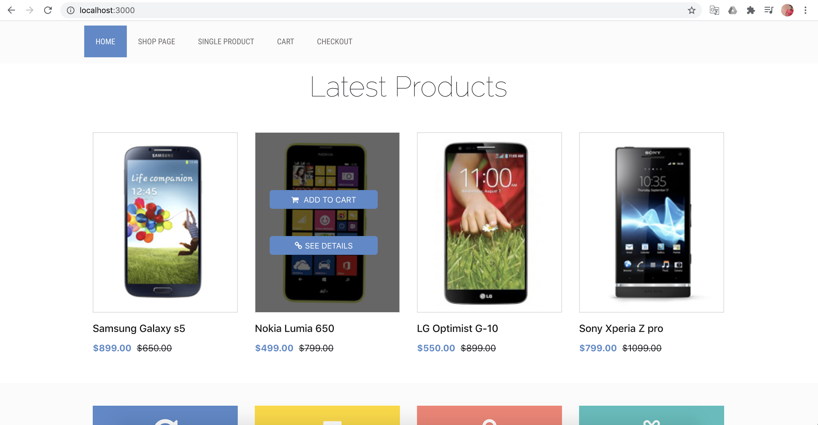

Slide 73
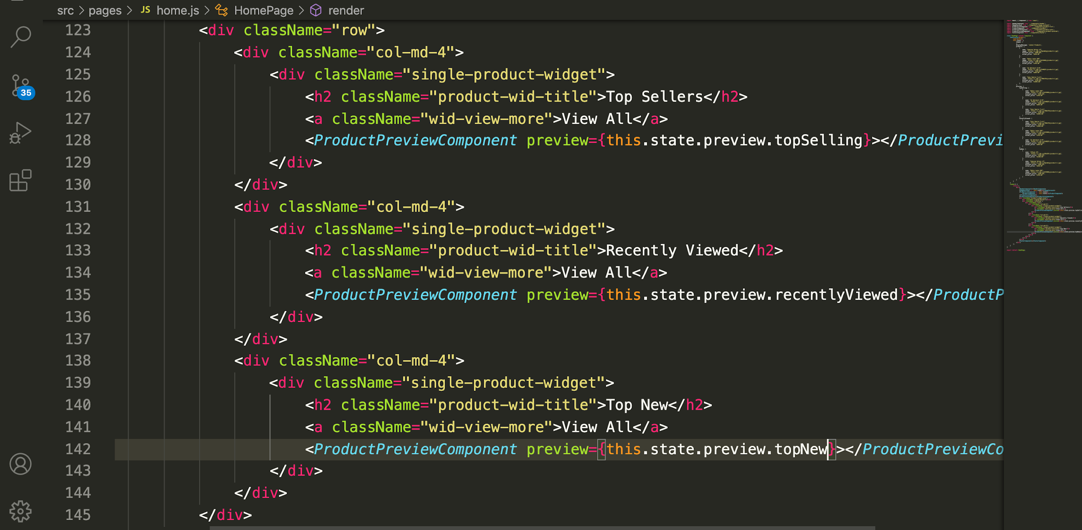
Home.js
Product preview component with different data

Slide 74
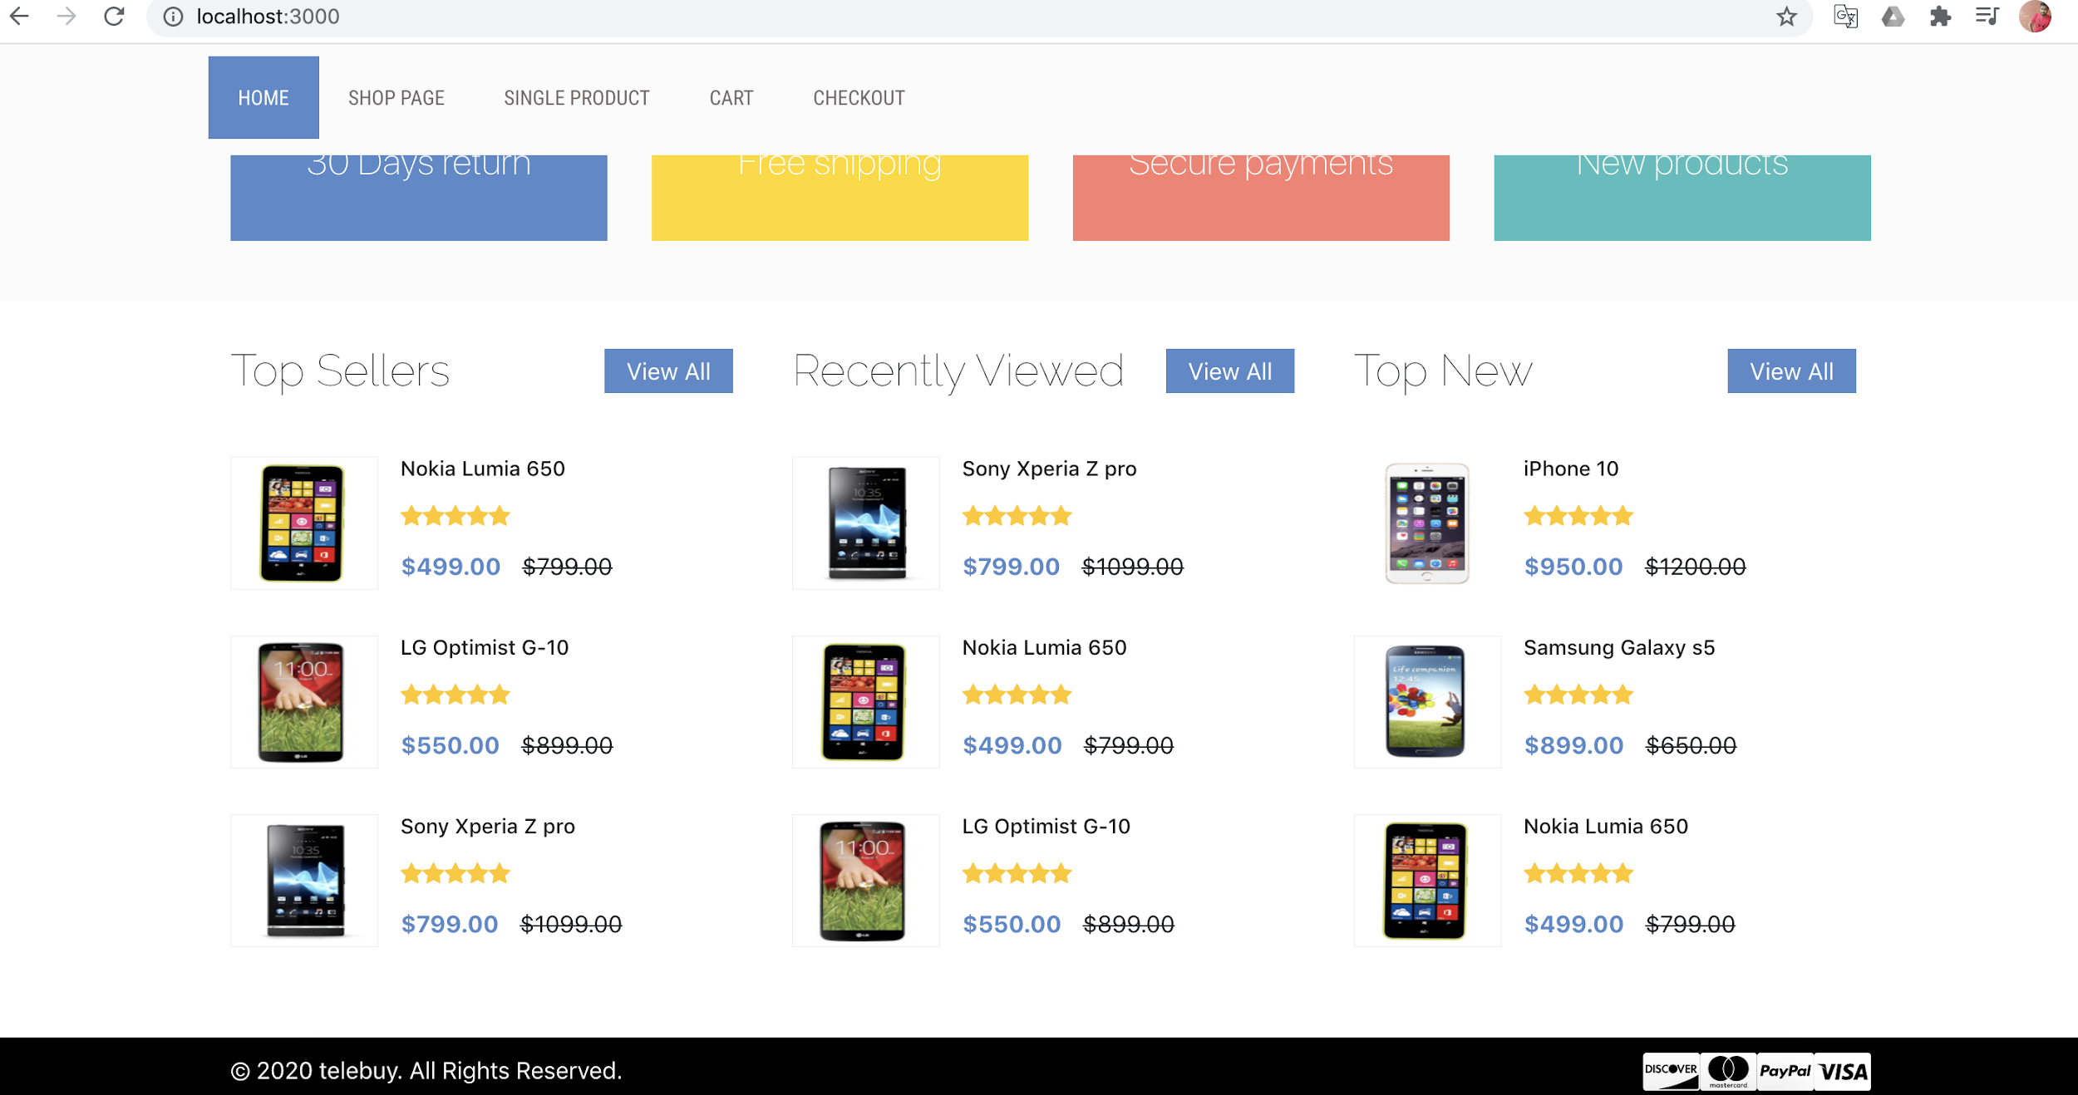

Slide 75
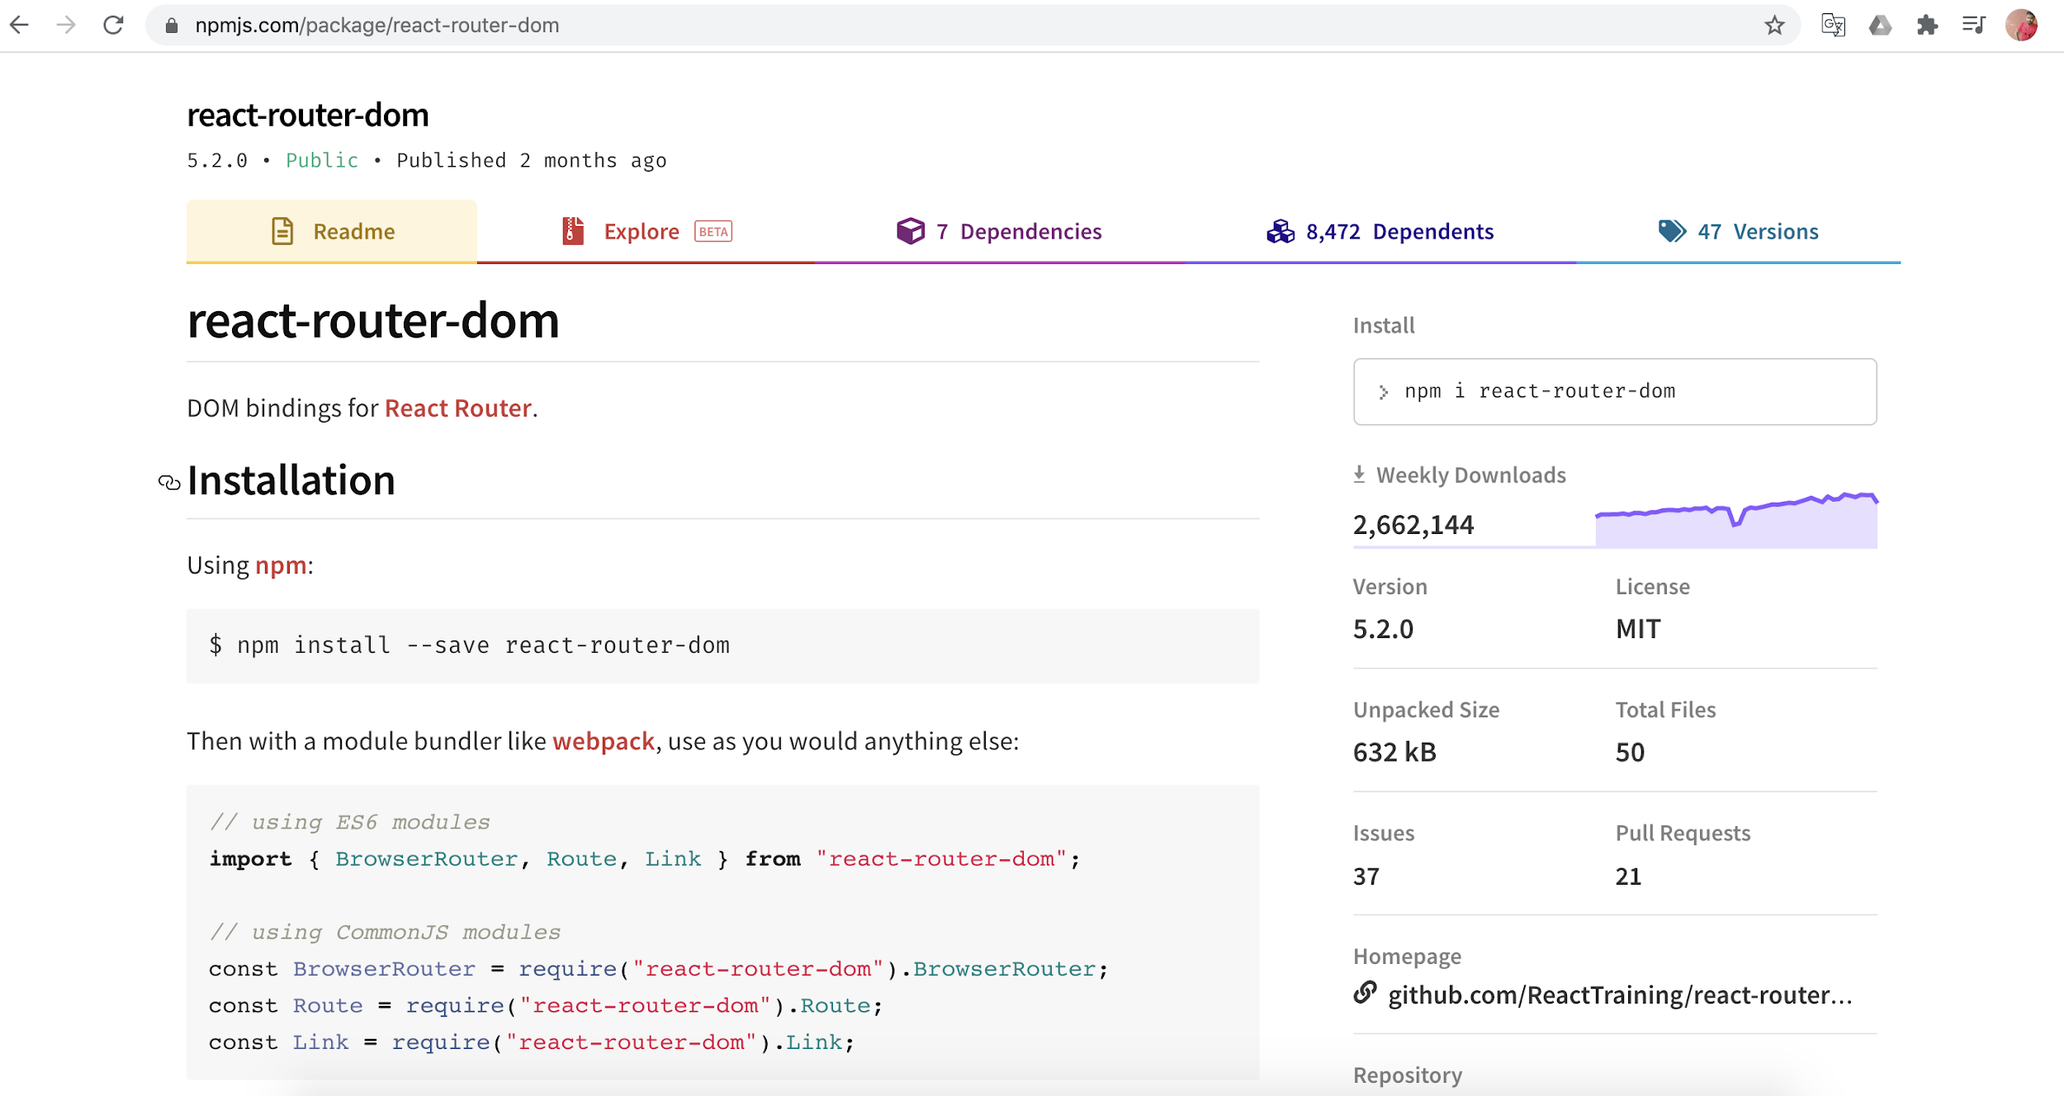

Slide 76
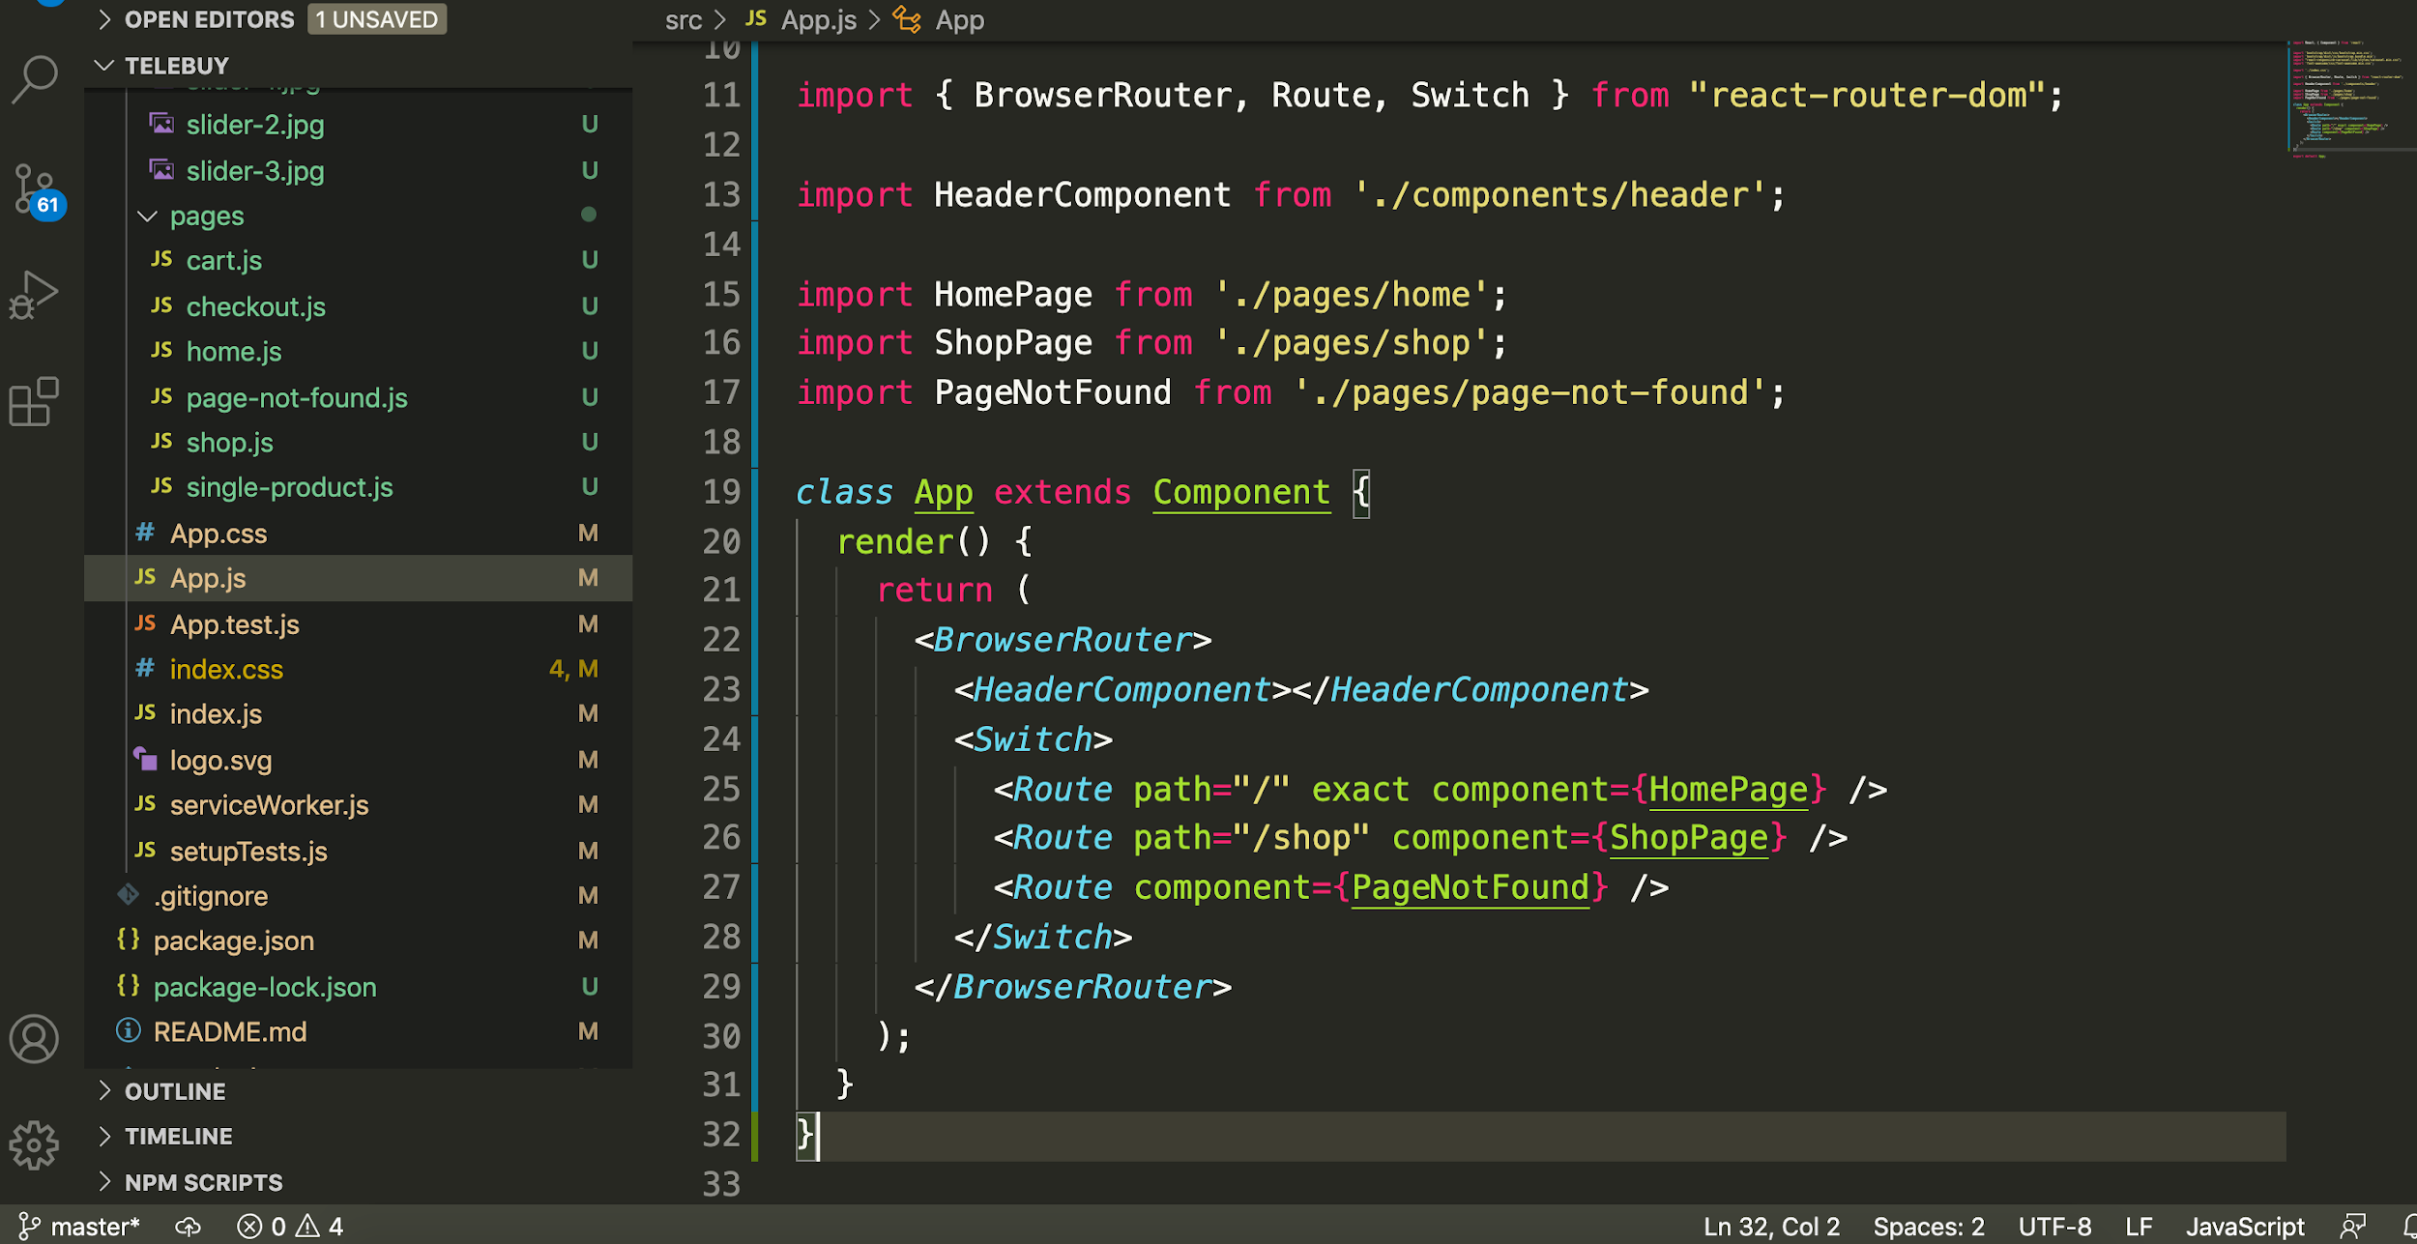

Slide 77
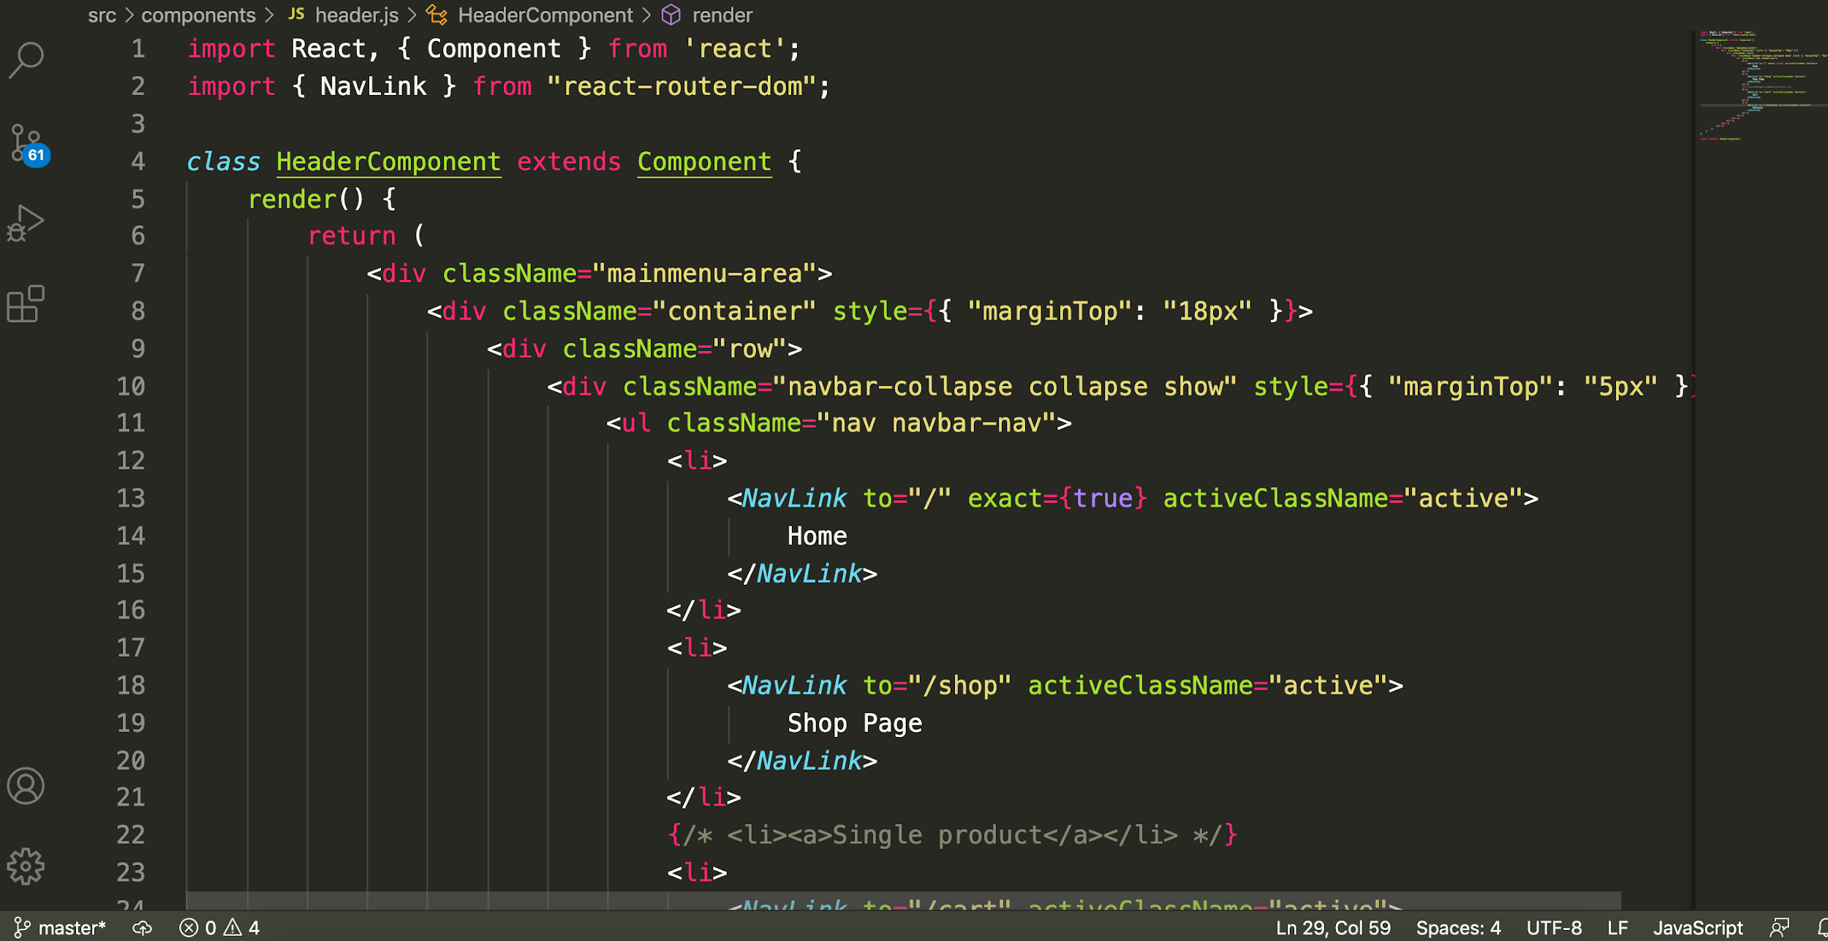

Slide 78
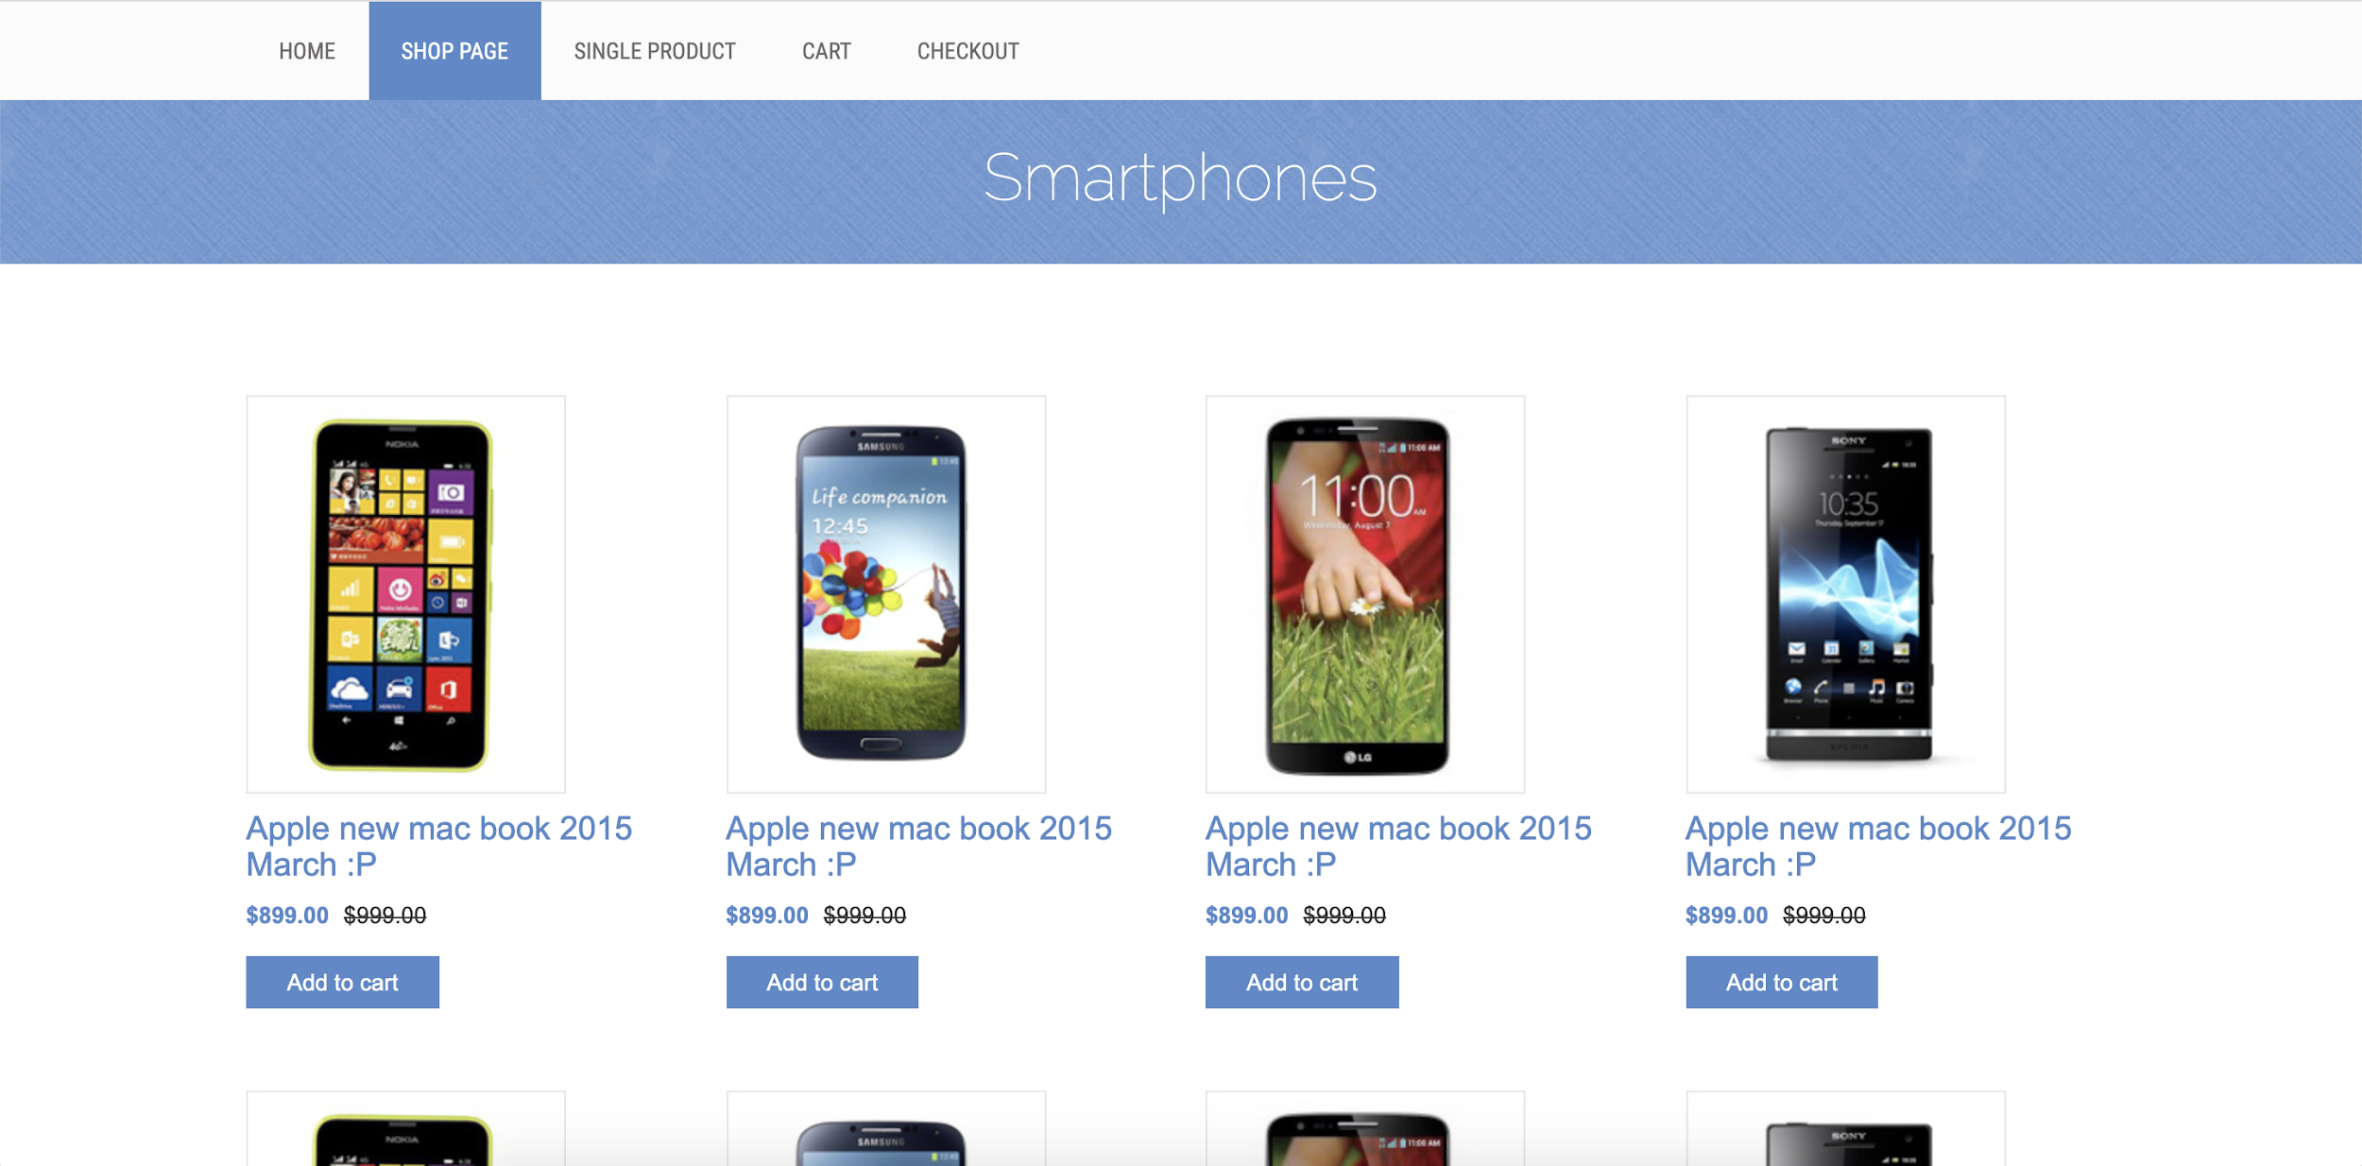
Header - Navigation Bar (Re-Usable Componenet)
Product List Component (Re-Usable Componenet)
Product Component (Re-Usable Componenet)

Slide 79
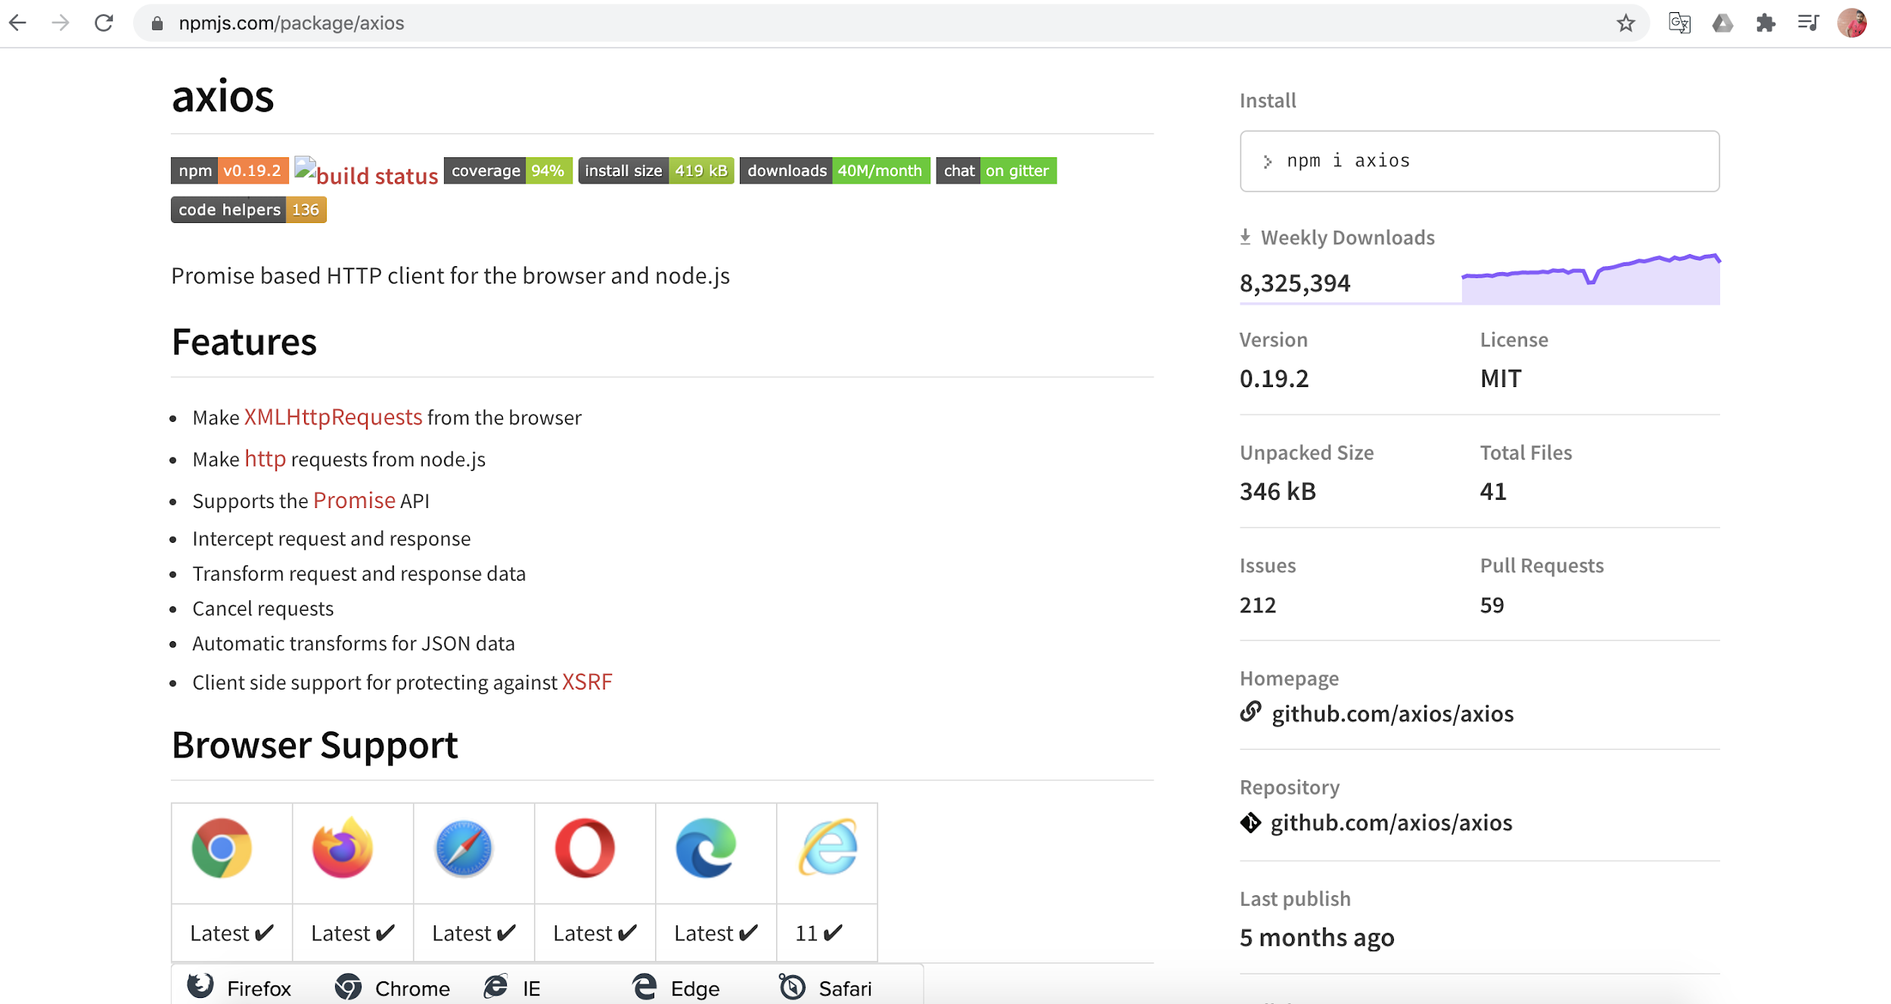

Slide 80
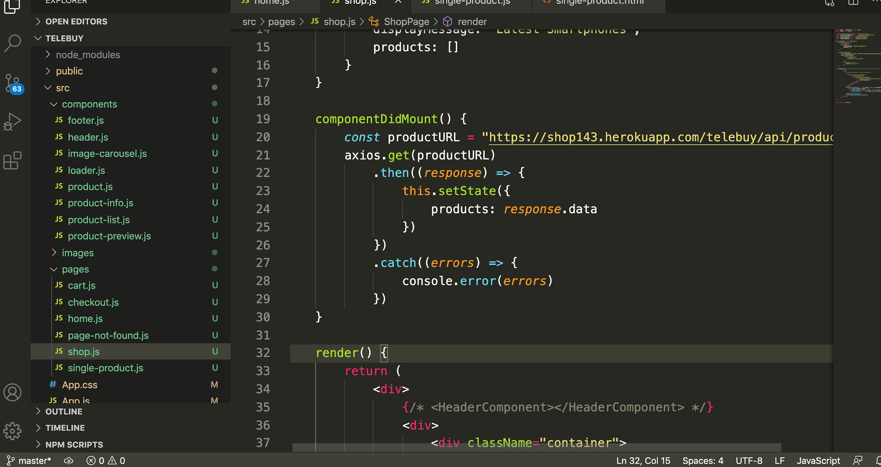

Slide 81
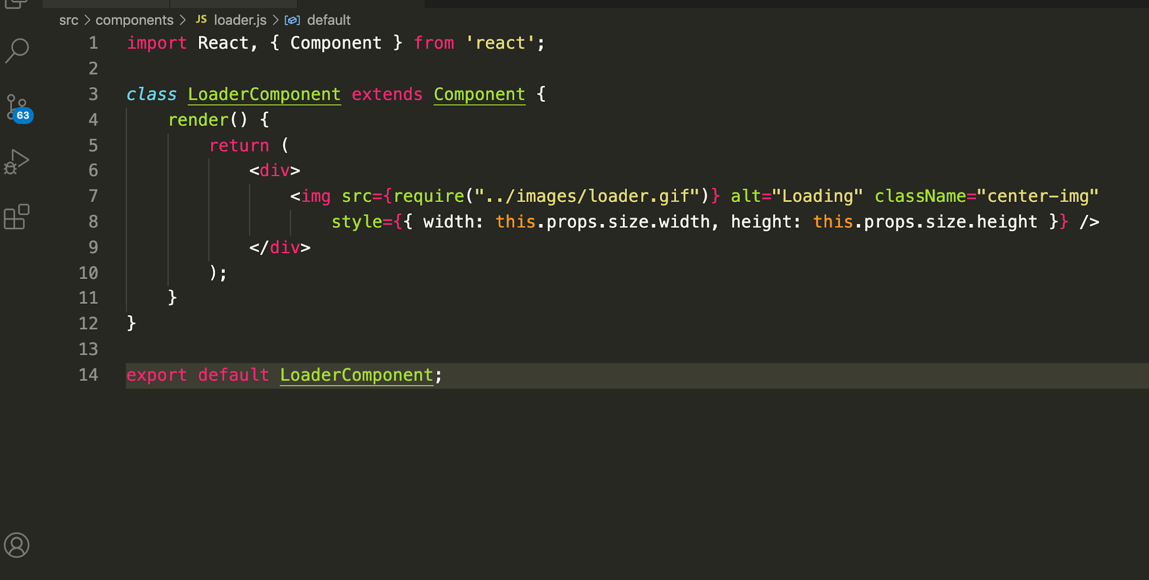
Loader component
Importing a GIF image

Slide 82
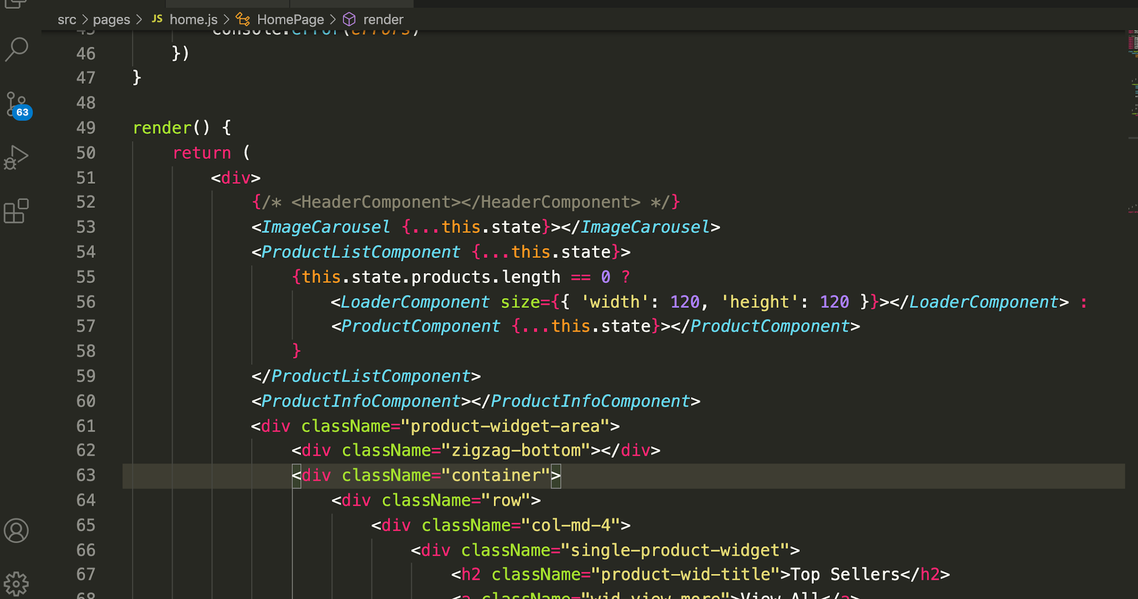
Conditional rendering to load gif and product component

Slide 83
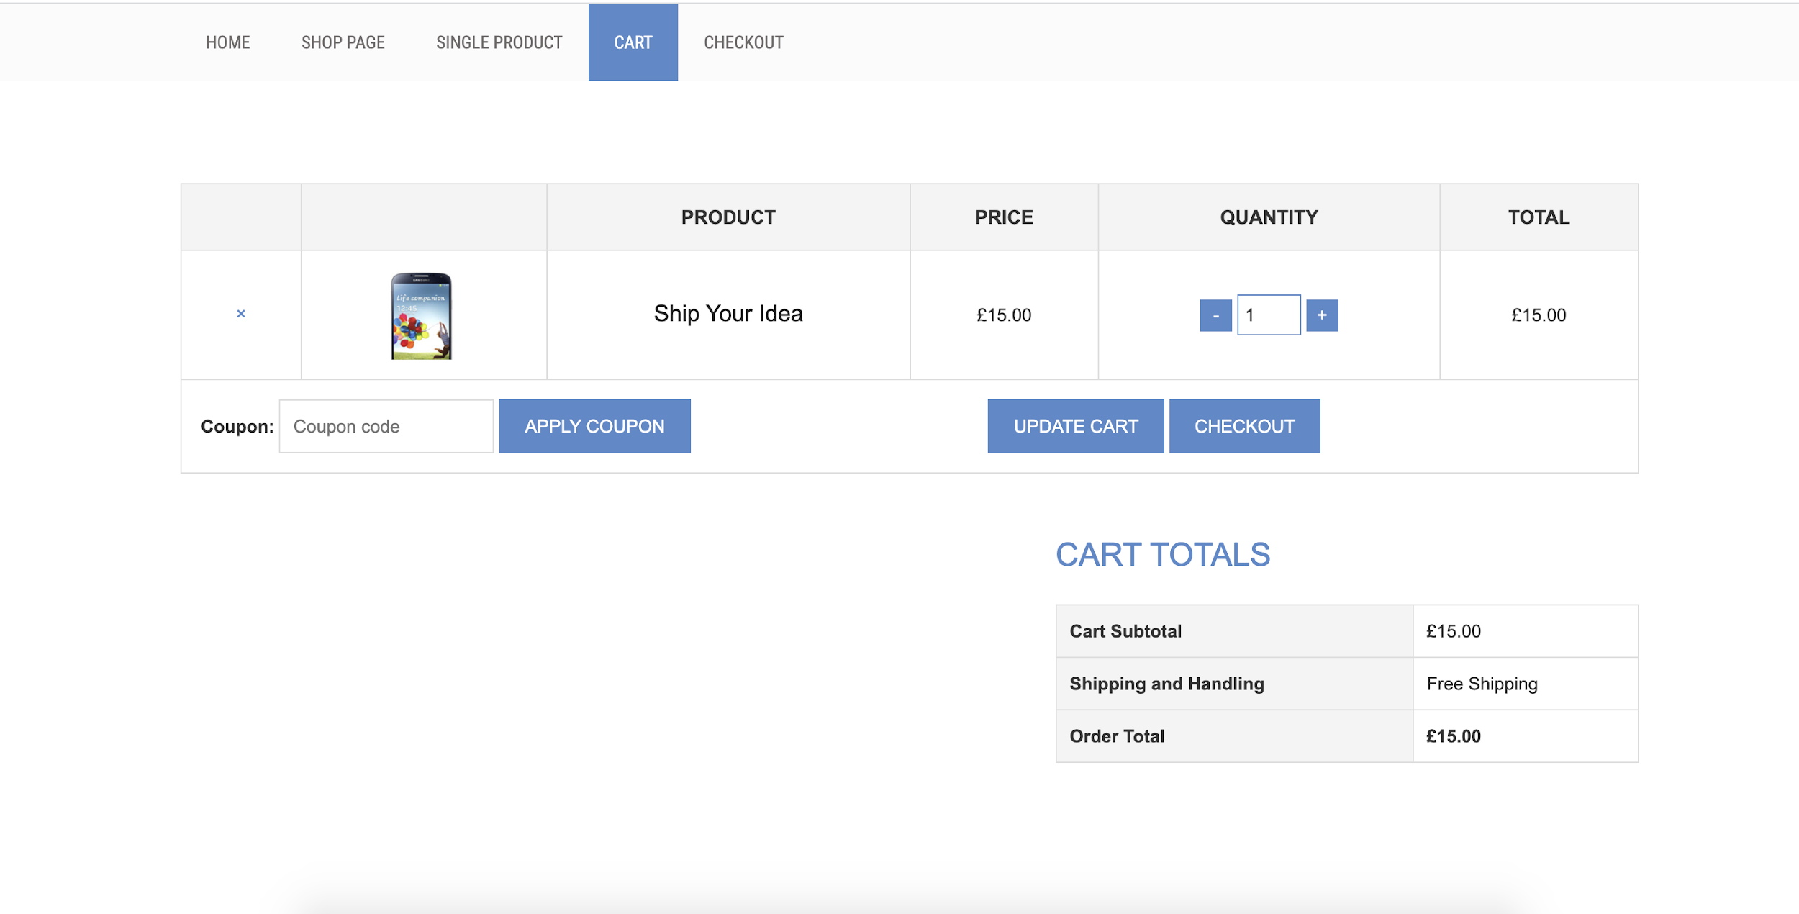
Cart Item Component

Slide 84
React Hooks

Slide 85
Introduction - Hooks
Hooks are a new addition in React 16.8
A Hook is a special function that lets you “hook into” React features.
Hooks are backward compatible.
Using hooks it is possible to express the same logic without an ES6 class.

Slide 86
Rules of Hooks
Only Call Hooks at the Top Level
Don’t call Hooks inside loops, conditions, or nested functions. Instead, always use Hooks at the top level of your React function
Only Call Hooks from React Functions
Don’t call Hooks from regular JavaScript functions

Slide 87
Types of Hooks
Using the State Hook
Updating the state in React, without setState
Using the Effect Hook
The Effect Hook lets you perform side effects in function components.
In useEffect serves the same purpose as componentDidMount, componentDidUpdate, and componentWillUnmount in React classes
Custom React hook
Building your own Hooks lets you extract component logic into reusable functions.

Slide 88
Redux

Slide 89


Slide 90


Slide 91


Slide 92


Slide 93


Slide 94


Slide 95


Slide 96


Slide 97


Slide 98


Slide 99


Slide 100


Slide 101


Slide 102


Slide 103


Slide 104


Slide 105


Slide 106


Slide 107


Slide 108


Slide 109


Slide 110


Slide 111


Slide 112


Slide 113


Slide 114


Slide 115


Slide 116


Slide 117

Synchronous vs Asynchronous

Slide 118


Slide 119
Redux Saga

Slide 120

Redux Saga
Redux-saga is a library that aims to make side effects easier and better by working with sagas.
Sagas are a design pattern that comes from the distributed transactions.
Saga manages processes that need to be executed in a transactional way.

Slide 121


Slide 122


Slide 123


Slide 124


Slide 125


Slide 126


Slide 127
Testing

Slide 128


Slide 129


Slide 130


Slide 131


Slide 132


Slide 133
Unit Testing - React with Jest

Slide 134
Unit Testing
Unit Test prevent regression, verify functionality and measure performance.
The value of tests is increased for large or distributed teams
Regression is a costly phenomenon, that is prevented by testing, where adding a new feature cause an old one to break
Unit Testing is most granular in scope, end-to-end testing the most broad.

Slide 135


Slide 136

What is Unit Test?

Slide 137
Test Driven Development (TDD)

Slide 138

Jasmine

Slide 139


Slide 140

What is Jest?

Slide 141

Features of Jest

Slide 142
Installation
React create app, it is ready to use and ships with Jest.
The only need to add react-test-renderer for rendering snapshots.
Command: npm i react-test-renderer
NPM: https://www.npmjs.com/package/react-test-renderer

Slide 143


Slide 144

Test Snapshot

